Slide 1
Dr Pamela Ugwudike
Department of Sociology, Social Policy and Criminology
University of Southampton
Supporting Young Fathers in Prison
Project Evaluation

Slide 2
Overview
Context
Methodology
Findings
Recommendations

Slide 3
Context
The number of children with a parent in prison is more than double the number of children who have been affected by divorce (ONS 2014).
Approximately 200,000 children in England and Wales are affected each year (Ministry of Justice 2012).
Ministry of Justice research shows that people in prison who lose contact with their families are much more likely to reoffend
(Brunton-Smith and Hopkins 2014)
No coherent ‘structure for accountability’ is available for prisoners and their families to maintain and develop family ties
(Farmer 2017:9; HM Chief Inspector of Prisons 2015)

Slide 4
The Evaluation was commissioned by Pact Cymru and conducted in three prisons.
50 stakeholders were interviewed:
  27 men in prison
  11 parents in the community
  8 Family Engagement Workers
  4 prison staff

Slide 5
The Evaluation sought to answer six questions based on the project's aims:
How does the project help parents in prison engage with their families from prison?
How does the project improve the behaviour of parents in prison?
How does the project direct parents in prison and their families to relevant sources of support?
How does the project support resettlement plans?
How are the processes of delivering the project associated with its key objectives?
What are the best approaches to improving future provision across the prison estate and the community?

Slide 6
  Accessing the Project
  Men coming into prison are informed of the project.
  There are information posters and flyers in the wings and visiting areas.
A Family Engagement Worker:
  ‘I’ll see the guys in induction to see if they need any help with their families, especially the first timers.
A parent in prison:
  ‘There’s signposting all around the prison and obviously, the girls [FEWs] are constantly round the wings. I mean they constantly there always around …they’re making sure that everyone’s family ties are kept basically’.

Slide 7
How does the project help parents in prison engage with their families from prison?
The project increases frequency of contact -
  Strengthens relationships
  Provides family-friendly alternatives to normal prison visits
  Evokes a sense of normality in an abnormal setting
A parent in prison:
  ‘It [access to visits] has increased the relationship with my partner. It gives me more of an opportunity to keep in contact with her and my little girl as well. So, it’s always a positive type of thing – it’s just more time – the time helps. I can get a better bond with my girlfriend and my daughter. Obviously, she’s still young [5 months] but it’s still nice to see her’.

Slide 8
How does the project improve the behaviour of parents in prison?
A parent in prison:
  Two hours with your family just having to feel normal for them two hours, not feeling like you’re in a prison, …it can change the whole mood … the way I felt when I left the family day visit that day, wow! I have a big smile on my face, head up high, smiling, like not even stressed, you know what I mean? I felt happy. Obviously because if I know that I’ve just seen my family and all, they’re happy and I’m happy, I’m getting along with everyone [in prison]
A Prison Officer:
  …[the visits] make it easier for everybody. Everyone gets to be relaxed which is what you want. [There are] no problems, just totally different, relaxed. When they go back [after the visit] they’re very different: calm, happy, relaxed, et cetera, you know, regular, good emotions only.
The project:
  Enhances emotional wellbeing
  Improves behaviour

Slide 9
How does the project direct service users to relevant sources of support?
Needs are assessed and individualised family action plans are prepared.
Access to prison-based courses and groups is provided.
FEWs Liaise with external services.

Slide 10
FEWs describing some of the services provided
I completely believe our services users have a voice and it’s really important that their voice is heard, so they have an input into the family action plan.
We do baby group, STAR relationship, Time to Connect and then Storybook Dads.
  [I] give them information and advice, liaising with social services is like a major part of that, helping with them get contact with their children if that’s in their best interest.

Slide 11
Service users describing some of the services provided
  I actually get up and go and do activities, drawings, baking cakes …like teacakes when you use all the trimmings and stuff on.
  I can play toys with her, I can run about, just do dad things with my daughter.
  My son was on the protection register. A member of Pact team went out to the meetings on my behalf. Anything really to do with my son, they help, really.

Slide 12
How does the project support resettlement plans?
Family Engagement Workers:
  ‘all our services are geared towards resettlement so everything that we do is more geared towards resettlement’.
  ‘if we’re aware that someone’s going to be released, we’ll go in and speak to them and see if there’s any support we can give in regards to family.…’.
  ‘we offer like a mediation or a family group conference…it is just building bridges between their partners’
The project:
  Provides ancillary resettlement services
  Organises resettlement-focused family conferences

Slide 13
SOME OBSTACLES
Prison Officers’ Perceptions
Prison staff are generally supportive of the service but some are more supportive than others.
Conflicting priorities
Prisons’ operational priorities can affect project implementation.
Lack of sustainable funding
Funding issues can affect staffing levels and project sustainability.

Slide 14
FEWS describing obstacles to implementation
I think that the mind-set [of prison staff] is changing. [Prison] staff that do become involved with us speak very highly and positively of us. In any job that you do, there’s always dinosaurs.
  If it wasn’t for Pact they [the men and their families] wouldn’t have the service, they wouldn’t know how to access things
  I think that gives Pact a bad reflection because the men and families are due to come in and have their Baby Group and then we’re saying on Wednesday morning, “Oh, I’m really sorry it’s cancelled” …that's been really distressing

Slide 15
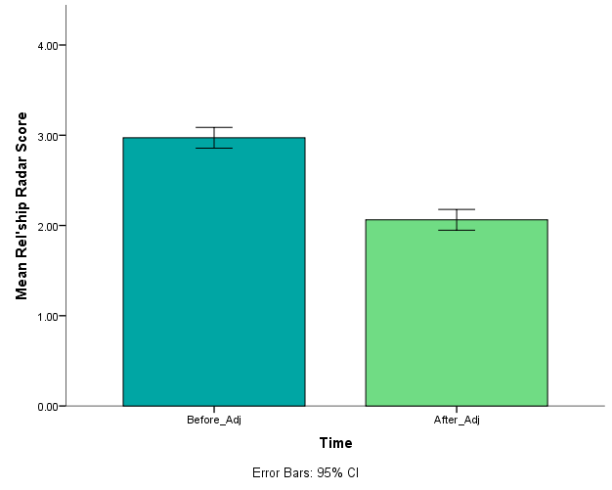
How are the processes of delivering the project associated with its key objectives?
Figure 1: Before and after mean Radar Scores
Pact Relationship Radar Results:
  Lower scores reflect more positive beliefs about quality of relationships with family members.
  The difference between ‘before and after’ Radar scores was statistically significant - p < .000 (two-tailed)
  Indicates that the project improves family relationships (Figure 1).

Slide 16
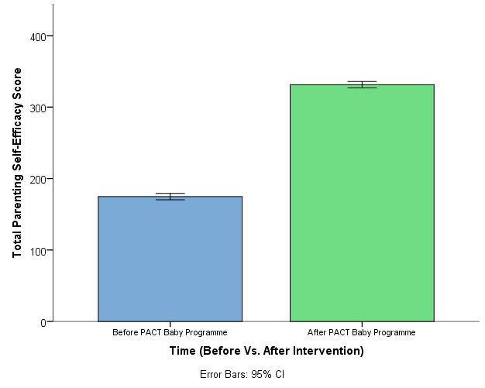
How are the processes of delivering the project associated with its key objectives?
Tool of Parenting Self-Efficacy (TOPSE) Results:
  Higher scores reflect stronger sense of parenting self-efficacy.
  The difference between ‘before and after’ Topse scores was statistically significant - p < .000 (two-tailed)
  Indicates that the project improves perceived parenting self-efficacy (Figure 2).
Figure 2: Before and after mean mean Topse Scores

Slide 17
THE PROJECT ACHIEVES ITS KEY AIMS
Increases the frequency of contact between young parents in prison and their families
Improves the behaviour of young parents in prison
Directs service users to relevant sources of support
Supports resettlement plans
Significantly improves family relationships, perceived parenting self-efficacy and promotes desistance

Slide 18
The Final Question & Recommendations
What are the best approaches to improving future provision across the prison estate and in the community?
Recommendations:
  Prisons should replace normal/ordinary prison visits with family-friendly visits such as those delivered by the Supporting Young Fathers in Prison project.
  Children should be given frequent access to family-friendly visits.
  Prisons should establish operational policies and communication channels in collaboration with family support services such as the Supporting Young Fathers in Prison project.
  Prison policy should reflect the importance of family ties; access to visits should be considered an entitlement not an earned incentive.
  Prisons should draw on insights from research on the importance of family ties and commission services such as the Supporting Young Fathers in Prison project. This will help address funding issues that can undermine the sustainability of such services.
  Domestic violence intervention could help parents avoid conflicts that damage family relationships.

Slide 19
References
Brunton-Smith, I. and Hopkins, K. (2014) Prisoners’ experience of prison and outcomes on release: Waves 2 and 3 of SPCR. London: Ministry of Justice
Farmer (2017) The Importance of Strengthening Prisoners' Family Ties to Prevent Reoffending and Reduce Intergenerational Crime. London: Ministry of Justice.
HM Chief Inspector of Prisons (2015) Annual Report 2014–15. London: The Stationery Office
HM Inspectorate of Prisons (2016) Life in prison: contact with families and friends. London: HMIP
Ministry of Justice (2012) Prisoners’ childhood and family backgrounds. London: Ministry of Justice.
Office for National Statistics (2011) Divorces in England and Wales 2009. Fareham: Office for National Statistics.

