Slide 1
Delivering effective visiting services: a families’ journey Lee Stephenson, Jigsaw Polly Wright, Barnardo’s
Notes:
Lee?

Slide 2
The reality
Acknowledgment that visit centre resources/buildings are different from one site to another.
Access to support and information in a safe and supportive environment should be available on every visitor journey regardless of resource available.
The visitor journey is often the only insight into the prison service – can impact on a visitors perception of how their loved one is being cared for.
Visitors are much more likely to stay in contact with an offender if their visiting experience is a positive one.
Visit centres provide a valuable way for prison to communicate and share information with offenders’ families.
“I was nervous about bringing my 2 year old son, but when I came alone and saw the other children playing, I was encouraged to bring him. I’m so glad I did. He has had such a wonderful time playing with his dad” Prisoner’s partner
Notes:
Lee?

Slide 3
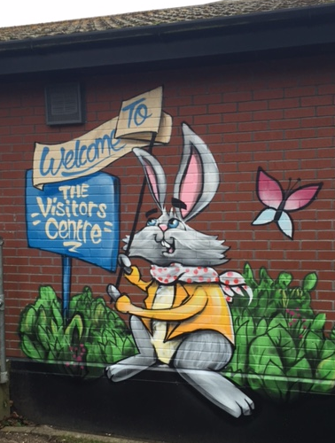
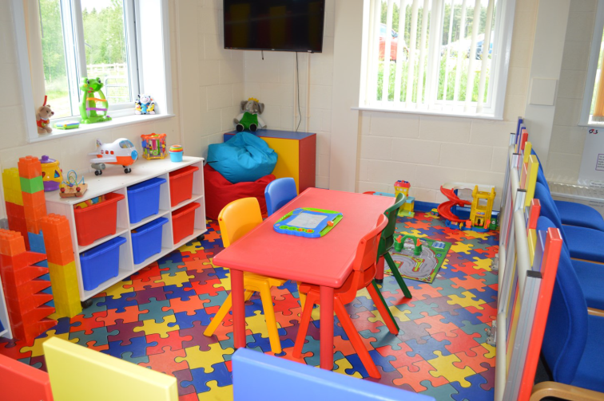
Arrival
Environment is accessible, clean, safe, warm, dry and clearly sign posted.
Basic provision:
Toilets
Refreshments
Lockers
Seating
Regular cleaning
Play provision (safe and clean)
Telephone helpline
Notes:
Lee?

Slide 4
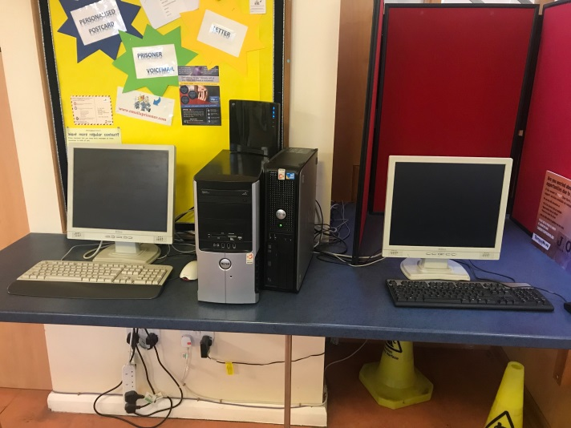
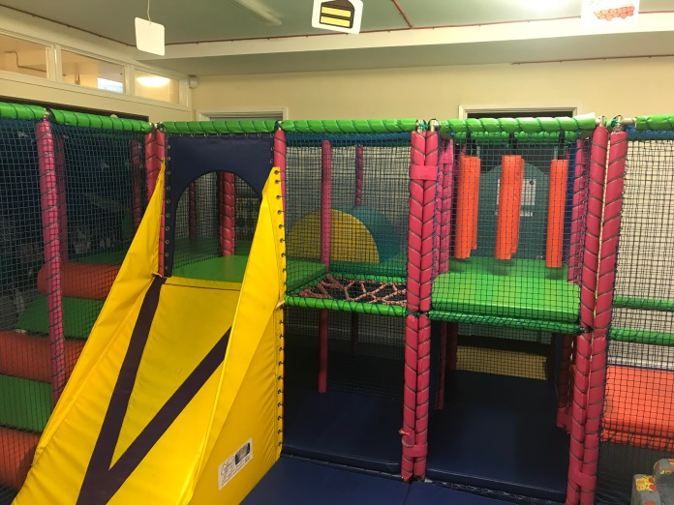
Consider fund raising activities, approaching organisations for donations and small capital grants for enhancing environment, such as:
Computers to support booking in and signposting
Play equipment to engage all ages of children
Equipment for sensory packs to support children with disabilities and/or sensory impairments
Notes:
Lee?

Slide 5
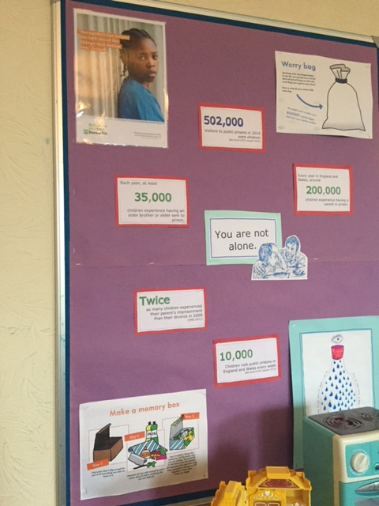
Staffing
Identifiable support staff and volunteers (uniform, ‘who we are’ posters)
Friendly, welcoming and polite (both VCS staff and prison staff)
Challenge the stigma and isolation that many families will feel in their communities.
“I have found it very helpful having someone I can talk to about my worries when I arrive, as I’ve been very anxious. It has meant that my visit with my son has gone better as I have been more relaxed when I enter the Visits Hall”
Mum of prisoner
“The visitors seem more relaxed and less agitated. I feel like there is less risk of aggression or confrontation. Before, visitors would get frustrated but now there is someone to listen and answer their questions” OSG, Prison Staff

Slide 6
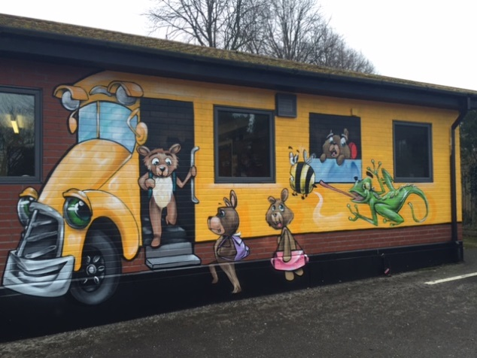
Process
Need to consider whole process from arrival, to booking-in, through security and into visit hall.
How do visit centre staff support families through the whole process?
Is it family-focused the whole way through?
Does it help to address waiting times, anxiety, stress etc?
Is the process clearly communicated to visitors on arrival?
Can the visit centre services be used to support families through other processes too e.g. to meet family members upon release?
Spot the alien!

Slide 7
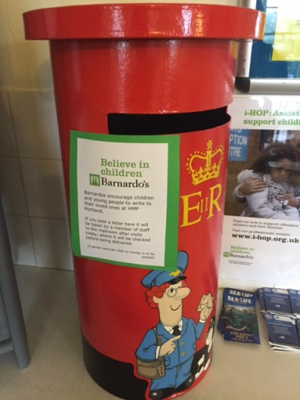
Support and information
Information packs for first time visitors.
Up to date information about visiting services on MoJ and provider sites.
Display boards, leaflets and/or information folders on:
Visit centre services and support
APVU
How to stay in contact with offender
How to contact the prison if you have concerns
Local and national services
(important to consider literacy, language, access and cultural needs)
Ensure safeguarding policy is communicated, embedded in practice and shared with prison.

Slide 8
Multi-agency working
Linking with prison departments and agencies working within the prison, such as:
SMS family workers supporting work in visit centre
Resettlement providers promoting resettlement programmes in the visit centre
Education detailing courses available to offenders
Safer Custody
Utilising resources in the prison: can carpentry workshop build equipment? Can offenders wrap presents at Christmas?
Opportunity for Children and Family Champions amongst prison staff
Should be embedded in wider prison Children and Family Strategy
Linking with external agencies
Food banks and supermarket Fareshare schemes to provide refreshments and/or food parcels
Local charities to provide resources and/or donations
Local agencies to promote support or provide drop-in information clinics
Local services to support delivery, such as Family Days

Slide 9
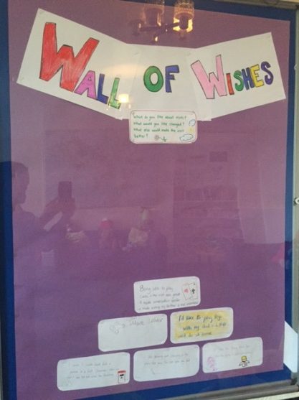
Feedback and monitoring
Ensuring all visitors, including children, have opportunity and are aware of how to:
Provide feedback on services received
Suggest ways in which the service is developed
Raise a complaint
Don’t just rely on forms or suggestion boxes, alternative methods:
Monthly family forums with Governor
Wall of wishes in visit centre

Slide 10
Ensure families know their voices have been heard and provide feedback on actions taken.
“Everything that has been suggested has been implemented: coffee and tea facilities, playing cards and lego for the older children, letter writing packs, etc. It’s great to see that our wishes are being considered.” Relative of prisoner
Consistent monitoring to understand who is visiting and what their needs are.
Part of the prison delivery plan (HMIP)

