Slide 1
Notes:
Before we do anything else, I’d like to introduce Michael Brown who is going to set the tone and rationale for this presentation and describe family learning from a range of perspectives. Michael..Mikey talks for three minutes.
Thanks, Michael, that pretty much sums up our presentation. But….why say less when you can say more.

Slide 2
“Family learning programmes actively involve families not only in maintaining relationships but also in enhancing parenting skills and building a joint vision of the future which does not include offending and which provides a more positive environment for children”
Department for Business, Innovation and Skills, National Offender Management Service (NOMS), Policis, Kingston University and Toynbee Hall
(2014) Parenting and Relationship Support Programmes for Offenders and Their Families

Slide 3
Context
Multiple and growing offer in Family Learning space
No single ‘answer’ or solution
Local, regional and national approaches
Complementary, diverse and distinct
Understand what you want to achieve
Notes:
We are delighted to be here today representing Pact (I’m Debbie Hornbuckle) and Safe Ground (I’m Charlie Weinberg). And, that’s all we’re going to say about our individual organisations because today we want to talk to you about the range of family learning opportunities and the fact that we actually represent a large number of allies and colleagues around the country doing really important work. We were asked to give what we see as the most important points in no more than 15 minutes, shared between us, so we’ve tried to break down some of those ideas:
There is no single way of delivering family learning that will do everything for everyone.
There are lots of important and well evidenced and established programmes, interventions and services you can find
Depending on what it is you want to achieve, you will need to consider your options, talk to providers and design creative ways of meeting the needs you identify. That might change and it might develop. Look for organisations that are flexible, communicative, professional and deliver quality. Don’t put price first. Put outcomes and relationships first.

Slide 4
Family Learning:
Involving families in sentence planning
Practical techniques and skills
Theory and therapeutic components
Concrete plans and actions for change
Notes:
Some of the most important points we wanted to share about the impact and potential of family learning are:
The opportunity to involve families in sentence planning. Good programmes and interventions do this consistently and in meaningful ways.
Alongside this, you can commission services and programmes that deliver real practical learning around caring for, bonding with, parenting and coping with children of different ages. Some programmes do all the above. What evidence is there for the service? Is it robust, clear and credible?
There are important elments of theory and therapeutic practice to consider when selecting your interventions. Does the work provide opportunities for participants to commit to transformational change? What are the outcomes going to include and how does that benefit your establishment and the culture of your work?
Does the intervention include concrete plans and actions to demonstrate change and development? What are they and how do families benefit? What do you want to achieve in the community as well as in your prison?

Slide 5
- Storybook Dads - a well-established family learning programme running in more than 100 UK prisons. Programme staff record imprisoned parents reading a story for their child either on CD or, in a few prisons, on film
Building Stronger Families - Building Stronger Families (BSF) supports the relationships between prisoners and their partners while in prison, building up and strengthening communication skills, money management and budgeting skills and parenting skills
Father’s Inside - Fathers Inside is an intensive group-work programme for men and young men in prison. The programme focuses on parental responsibilities and children’s education, development and wellbeing
- Triple P Parenting - a set of evidence-based parenting programmes focused on developing positive relationships, attitudes and behaviour. “Triple P” is currently delivered in 25 countries, comprises different levels of intensity, and can be adapted for different family structures.

Slide 6
Family Learning
Invest resources
Plan ahead
Be bold
Take it seriously
Notes:
This isn’t necessarily easy and, whilst ensuring you have quality healthcare, buildings maintenance, core education provision, workshops and industries, catering, security and discipline all on point, adding family learning to the mix can feel like an added extra. We get that, but we are urging you to consider the value of family learning as absolutely priority along with everything else. Desistance theory is clear that family and children are often significant drivers for change and we know children of people in prison are at risk of criminal justice involvement. Work with the notion that engaging men and women with family learning will add value to your overall vision. Consider how to get your departments to take this on and be brave about that. The more seriously you take family learning, the more seriously families will be able to work with you and your colleagues to ensure the most beneficial outcomes for us all. Nobody wants people in prison. Supporting families can only be a way to keep everyone safer, more responsible and accountable. This short clip gives a really good example of some of the possibilities we’re talking about. CLIP 2 mins.

Slide 7
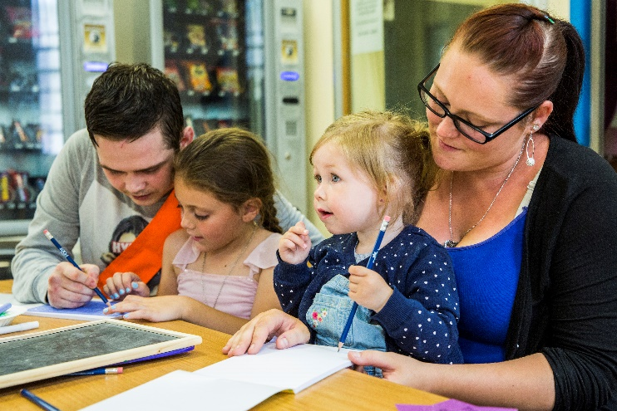
“This (course) is brilliant. It’s making him realise being a dad is so important and that when he comes out he needs to stop offending to be around for his kid”
Quote from a prisoners’ wife who participated in Pact’s Family Literacy in Prisons course

Slide 8
“I mean we felt that we were achieving something…prison officers and prisoners that were working together”
Prisoner quoted in Halsey, K., and Ashworth, M., ‘Made for prisoners by prisoners‘: an evaluation of the Safe Ground parenting and family relationships programme (London: National Foundation for Educational Research, 2002), p.71.

