Slide 1
Delivering Effective Family Practice
28 February 2018

Slide 2
Our Strategic Objectives
A prison and probation service that reforms offenders by:
Maintaining the highest level of public protection
Keeping prisons safe, secure and decent
Supporting offenders to reform
Reducing reoffending

Slide 3
What are we here to do?
All of us work to make a real difference to the lives of others and, in doing so, protect the public.
Openness
All of us must exercise our authority wisely and with integrity, with decisions that are fair and consistent.
Our job is to deliver the sentence and orders of the courts safely and securely, within a culture of decency and respect that enables rehabilitation.
As colleagues we innovate, share and learn as we develop and improve our professional practice with investment and trust in the skills of our staff to do their jobs well
Together we work as a team to protect the public and reduce reoffending.
As an employer and as colleagues we respect and value everyone and look to motivate everyone to be the best they can be.

Slide 4
Why it matters…
“Family and significant relationships are considered as a key means by which we can prevent reoffending and reduce the likelihood of intergenerational crime. Supporting a prisoner in a meaningful and constructive relationship with his or her family or significant others, should be a primary focus for anyone caring for those in custody who hope to achieve positive change and transform lives.”
*Quote from Delivering Effective Family Practice Operating Guidance issued December 2017

Slide 5
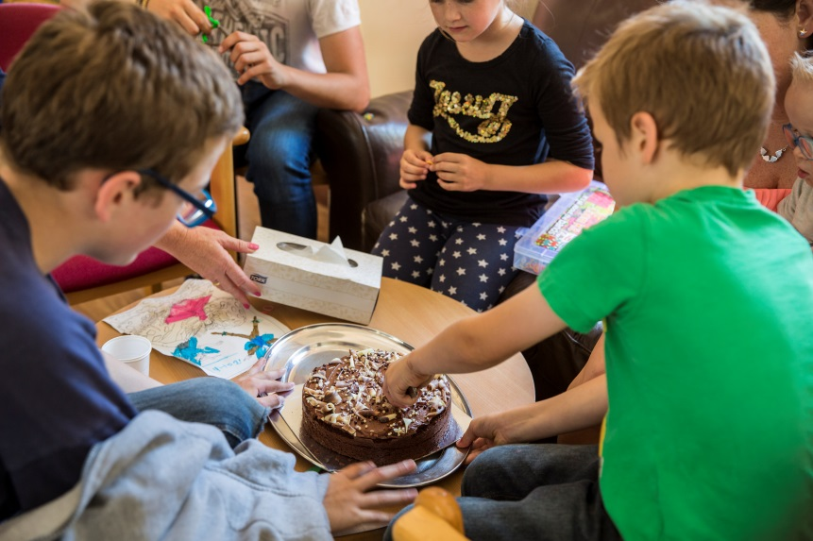

Why it matters…
“For a child I think it’s very intimidating
and scary to have to go through”
–
Parent
referring to walking through a prison with
their child on a visit
Each year, 200,000 children experience the imprisonment of a parent in England and Wales and half a million visits are made by children to public prisons

Slide 6
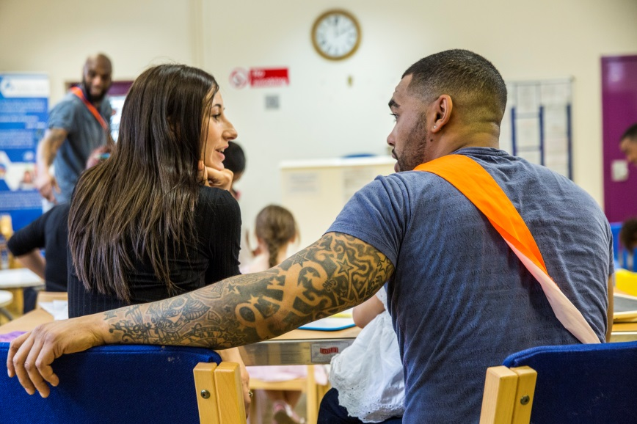
Why it matters…
Prisoners who receive visits from family members are 39% less likely to reoffend
Reoffending rates are 21 percentage points higher for people who said they had not received family visits whilst in prison compared to those who had*
Around 43% of prisoners lose contact with their families
Only three in ten prisoners reported that it was easy or very easy for family to visit them at their current prison – 16% said they did not receive visits*
*Statistics taken from Bromley Briefings Prison Factfile Autumn 2017

Slide 7
Did you know?
The Assisted Prison Visits Unit Contact Centre has provided an ‘in house’ bespoke visits booking service since 2011 and recently expanded to 21 public sector prisons.
A contact centre approach was developed to allow legal/official visitors to use both email and phone service and social visitors both online bookings (24/7 availability) and phone calls – not losing that personal interaction.
In 2017 we made over 100,000 bookings on behalf of prisons
Handled 119,919 calls relating to prison visits
Our USP:
  Opening hours from 9am – 6pm Monday to Friday
  Front and Back office approach to ensure all business areas - legal and social visits requests are met
  Birmingham based location and economies of scale will reduce staffing costs
If you would like to know more…
    Please speak to us here today or contact APVU at APVU Management in the GAL

Slide 8
Did you know?
The Assisted Prison Visits Scheme contributes towards the cost of travel to prison visits. It is open to close family members and significant others who are on a low income and allows for one visit every two weeks.
During January 2018 the Assisted Prison Visits Scheme contributed to the cost of 2983 unique visits.
The average cost per visit was £33.11
Customers can claim directly online at gov.uk/helpwithprisonvisits.

Slide 9
Our partner organisations
In our recent procurement across Public Sector Prisons the following partner organisations were successful:
      Barnardo’s Sodexo Justice Services
      Choices Consultancy Services Spurgeons
      FAST VCSG
      FoPP (Sodexo) YJB
      G4S
      HALOW
      JIGSAW
      LAT
      NEPACS
      Ormiston
      PACT
      POPs
      PSS
      SERCO

