Slide 1
Family Interventions & Stakeholder Engagement
Barriers to Family Interventions
Culturally & strategically unimportant
Lack of financial resource
Limited staff to implement
Limited space & facilities
No clear accountable lead
Inexperience of stakeholder engagement
6
5
4
3
1
2

Slide 2
1. Culturally & Strategically Unimportant : suggestions…
Research, understand, accept – Government endorsed international evidence base that FI are a key causal factor in reducing current and next generation offending.
Embed priority documents into your strategy e.g. LF Recommendations, HMIP Expectations, HMPPS Guidance.
Integrate FI strategy across departments – create synergy with RR strategy, substance misuse, safer custody, L & S, security, etc.
Identify and promote interdepartmental benefits
Once the cultural Rubicon is crossed… don’t relax!

Slide 3
2. Lack of Financial Resources: suggestions…
Identify and protect the Governor devolved budget for FI (2017)
Innovate income generating opportunities – eg visits & VC café, (Britannia HMP Norwich) become a training venue (Hidden Sentence).
Develop a bid submission ability, as an establishment, and as a partner
Map relevant local/national community cross sector organisations – host community awareness events in the visits hall.
Identify mutually beneficial objectives – joint submissions eg BIG Lottery, Local Authority slippage, Community Grants, etc.
Nurture and protect your new friends in your partnerships.

Slide 4
3. Limited Staff to Implement : suggestions…
Successful partnership bid submissions usually create new staffing capacity to deliver.
Successful internal income generation, creates/ frees up staff for FI
Successful interdepartmental synergy identifies staffing slack, to redistribute, op’ and nonop’… Essentially more efficient staffing model.
Develop / evolve your volunteer strategy, including vetting & training. Partnerships with local universities, CLINKS, volunteer bureau, Erasmus, etc. Volunteers are a huge untapped seam of skilled, enthusiastic, and free resource.

Slide 5
4. Limited Space & Facilities : suggestions…
Most underused and overlooked space in the prison… visits facility.
Identify the down time to create FI opportunities.
There is always down time! (1750 – 77% - 6000+) Analysis of visiting trends, respond to supply and demand.
View and use the visits facility as a custody & community resource.
Be creative and bold with other prison areas where safe to do so. FI in the gym, library, Multi-Faith, open-air spaces, etc

Slide 6
5. No Clear & Accountable Lead : suggestions…
Identify a clear and accountable lead!
Tagging this strategy and responsibility onto someone’s existing role, who does not posses the sufficient rank, clout, experience, or personality is pointless, and will fail.
Be strategic, choose carefully who is given the senior accountability, someone who can then identify and enable a team to champion FI.
Look after them!

Slide 7
6. Inexperience of Stakeholder Engagement : suggestions…
A successful and sustained attack on steps 1 – 5 will largely negate this barrier.
In so doing, you will develop stakeholder engagement that is specific to the needs of your establishment.
As the stakeholder engagement process embeds and grows… protect it jealously!
Promote and celebrate partnership successes using approved media platforms.
Once the cultural Rubicon is crossed… don’t relax!

Slide 8
The HMP Parc FI strategy is supported by over 45 partners including…

Slide 9
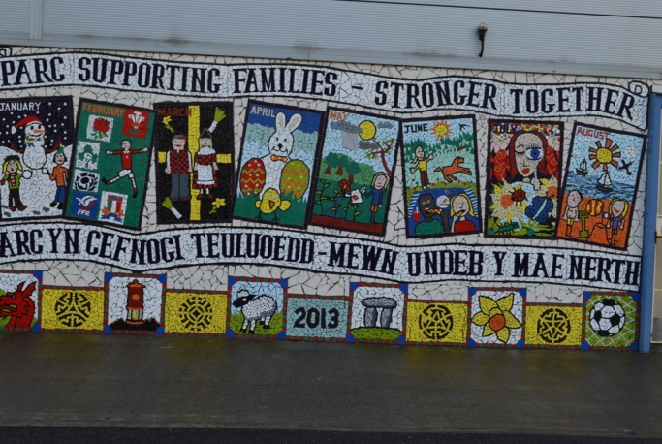
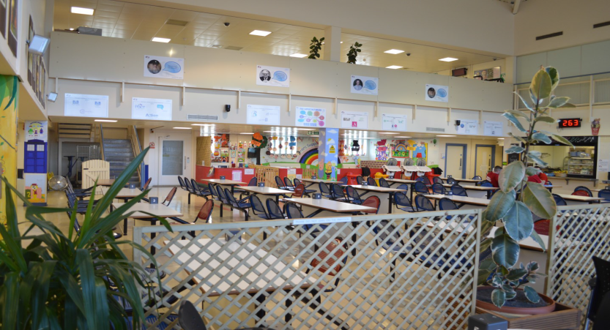
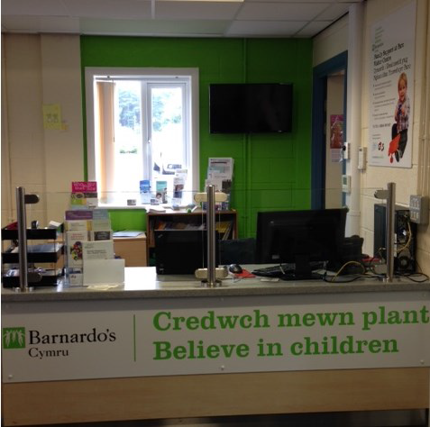
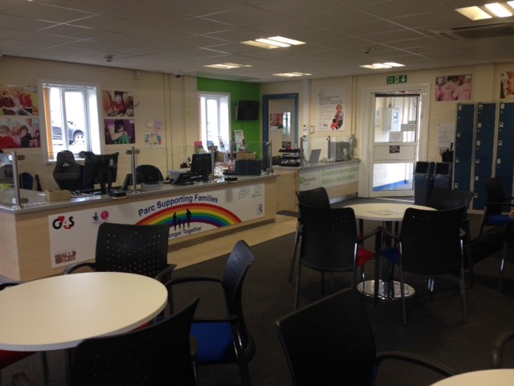
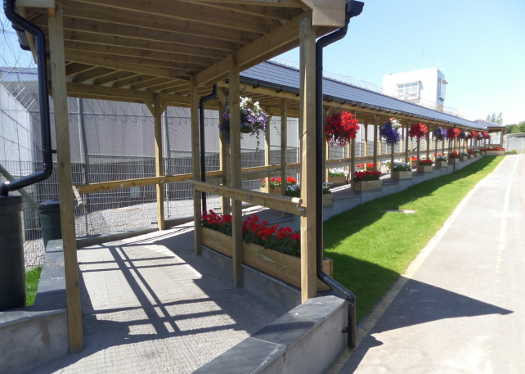
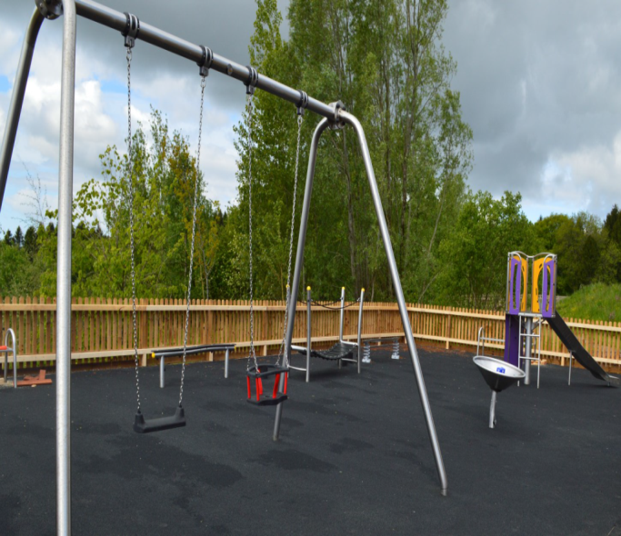
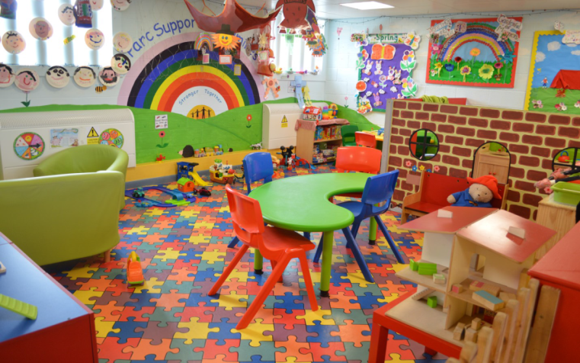
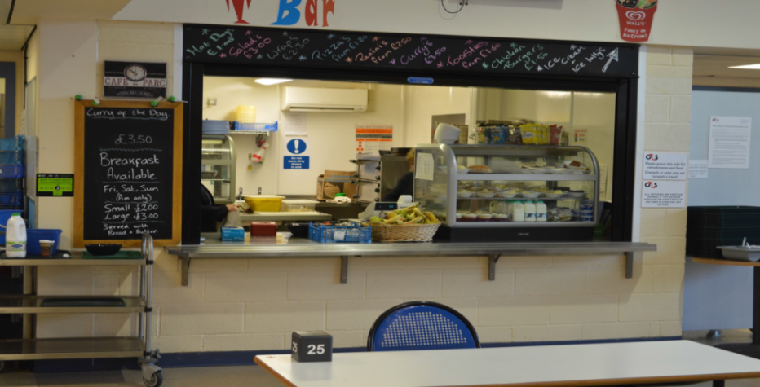
Reverse engineering prison visits & family interventions…

Slide 10
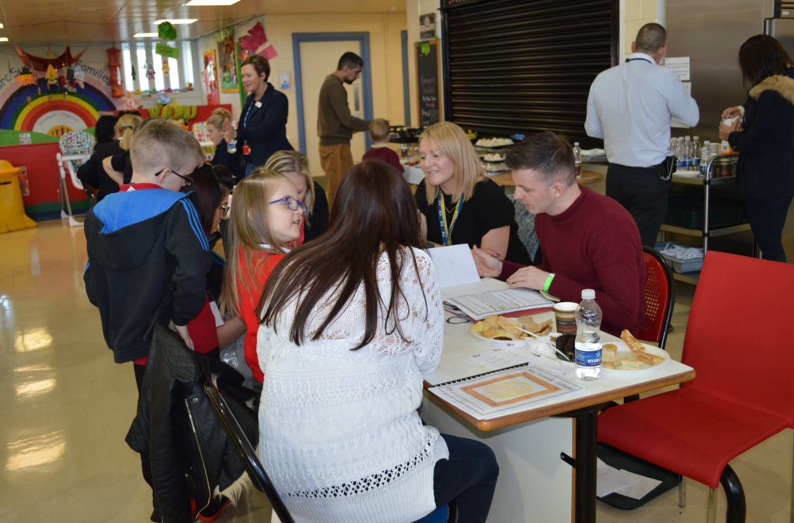
Children’s Showcase Event HMP Parc – Parent/teacher events since 2015
Son, 9 and daughter 6 years.
3 School Teachers attended for one family.
Mum and Dad said :
‘I didn’t know what to expect but it was like attending the school
The school has been so supportive throughout his sentence
The children were excited to show their school work’
Teachers Feedback
‘The children were excited to see dad
‘Good for the school to have links with dad
‘Interesting seeing their relationship with their dad
‘We had a clear outline of what was expected

Slide 11
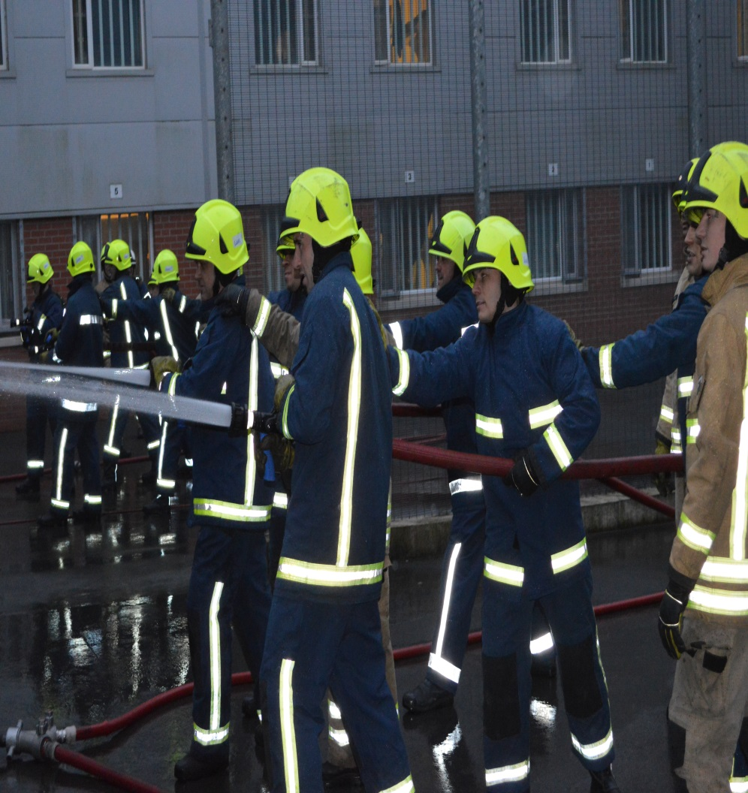
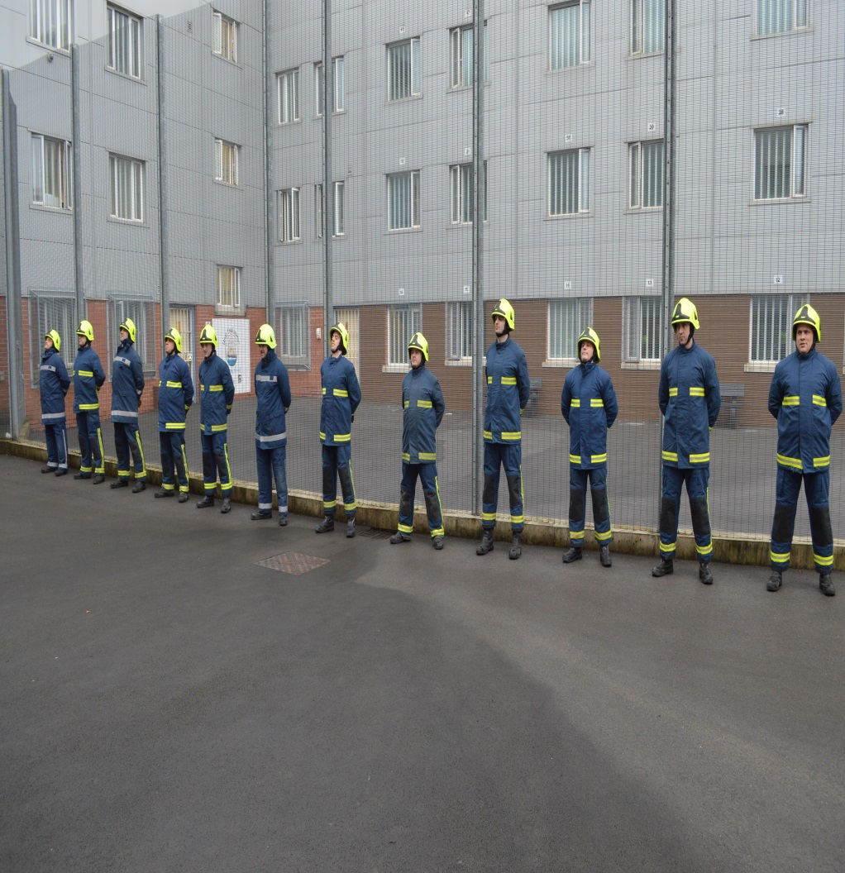
Fire Fighter For A Day… with South Wales Fire & Rescue Service since 2015

Slide 12
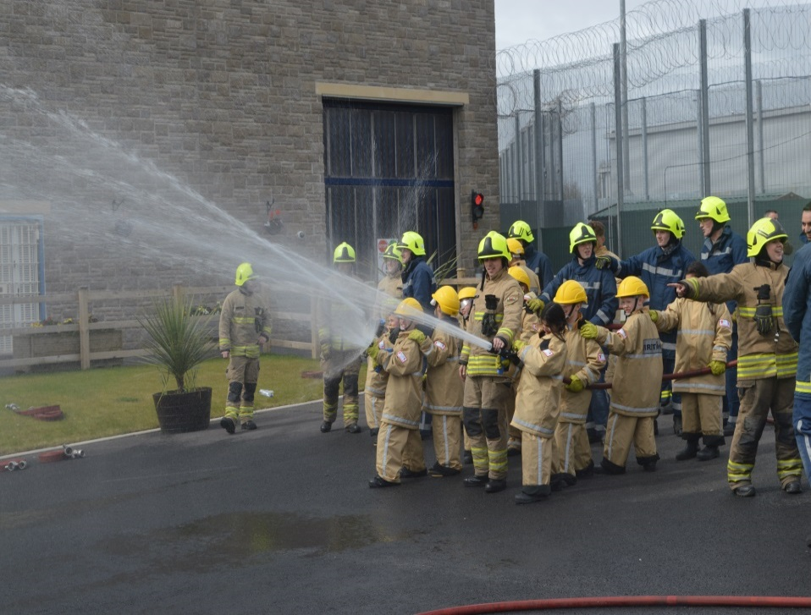
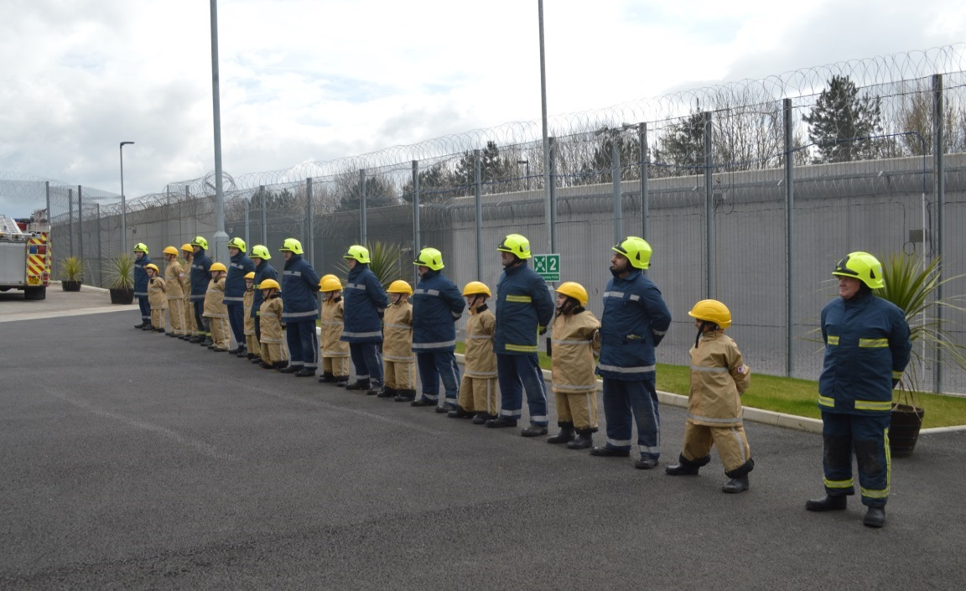
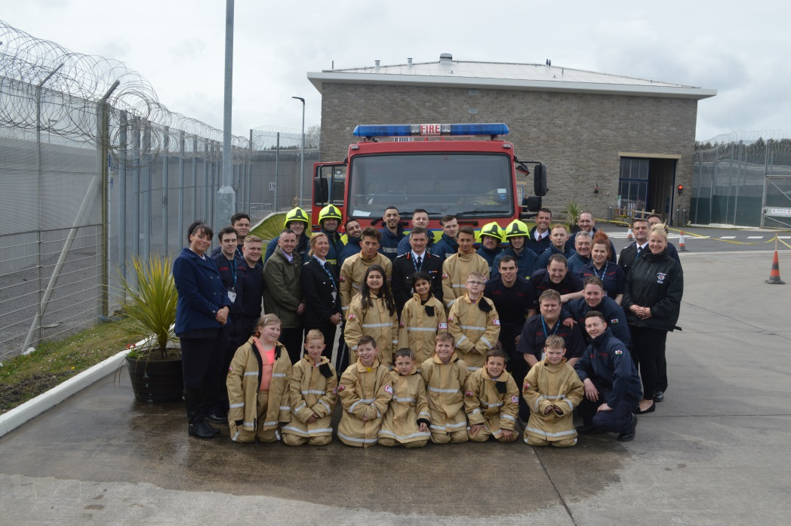
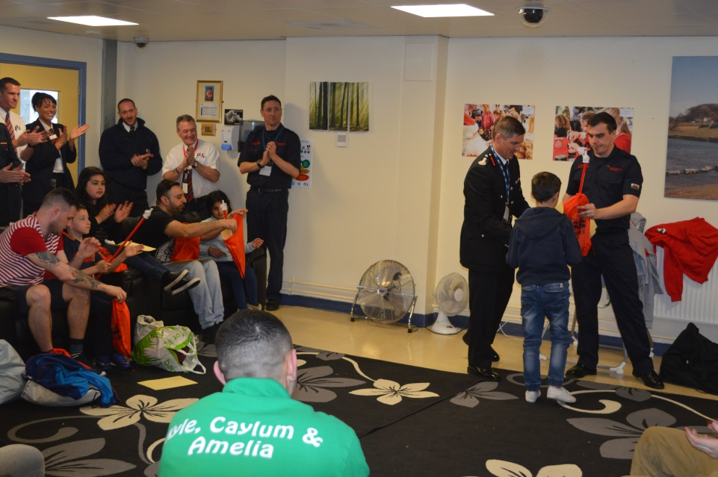
Fire Fighter For A Day – Dad’s & their children version… with South Wales Fire & Rescue Service since 2016

Slide 13
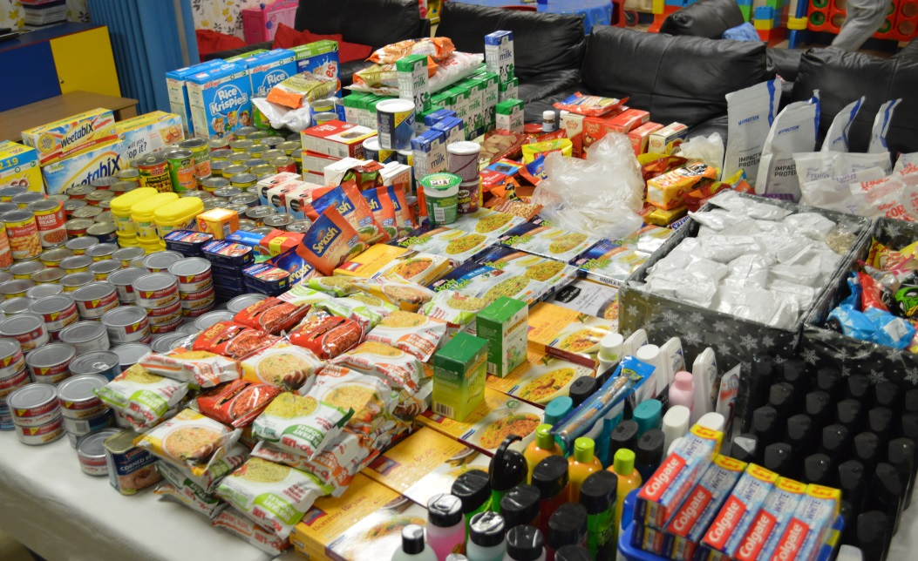
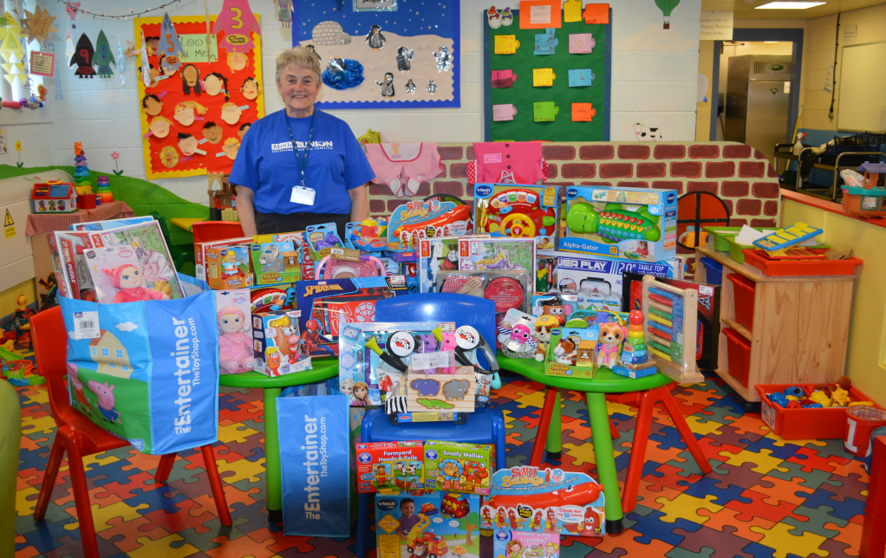
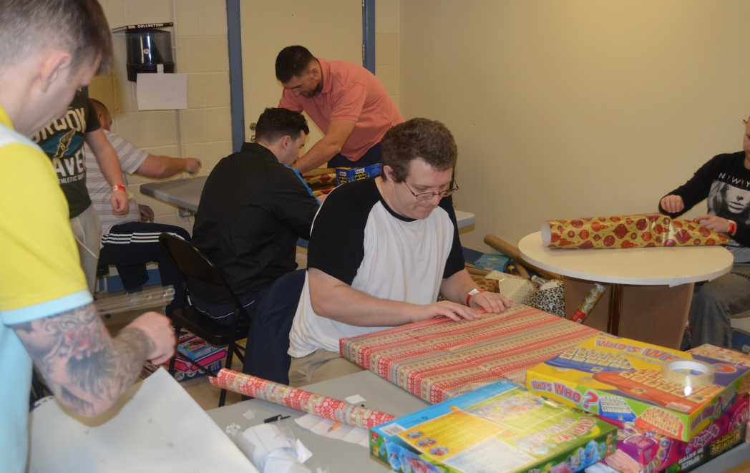
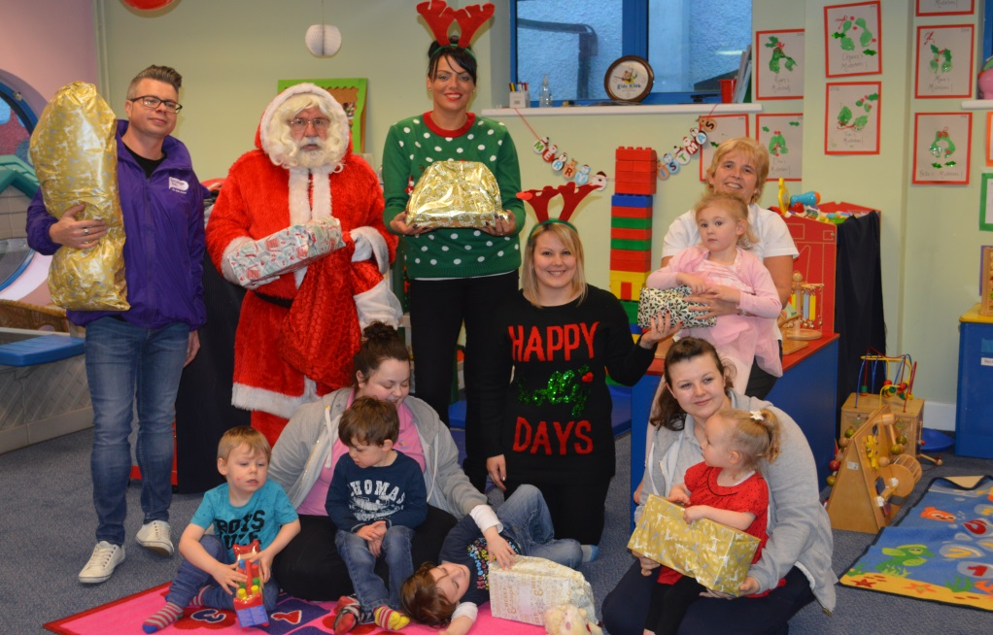
Food Bank Appeals & Nation Radio Toy Appeals for children’s hospices in Wales

Slide 14
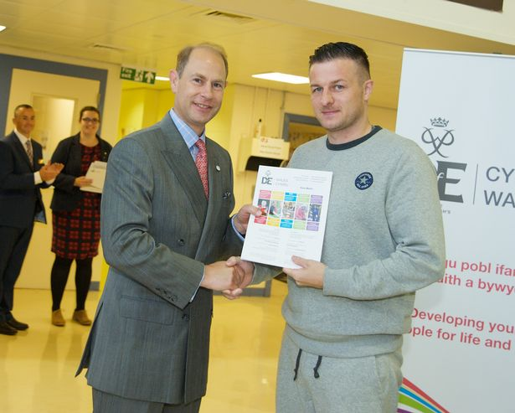
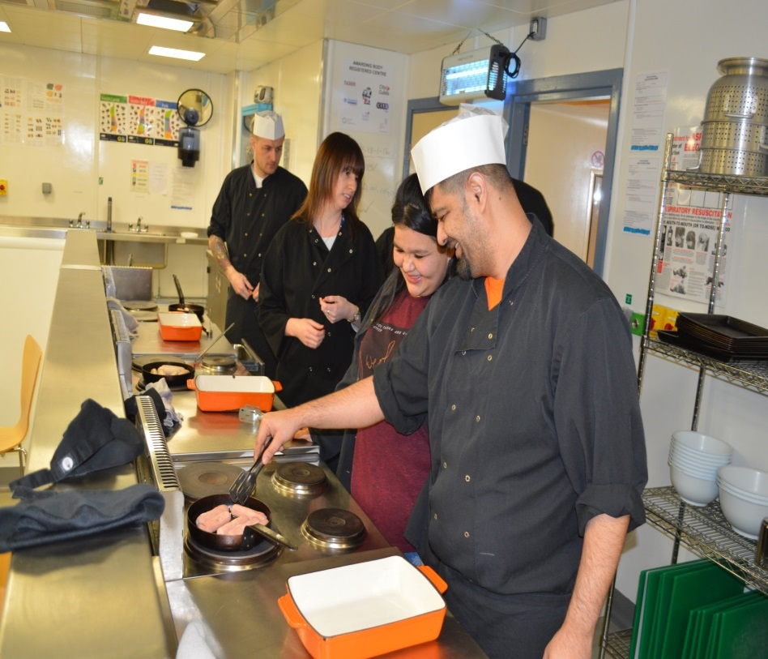
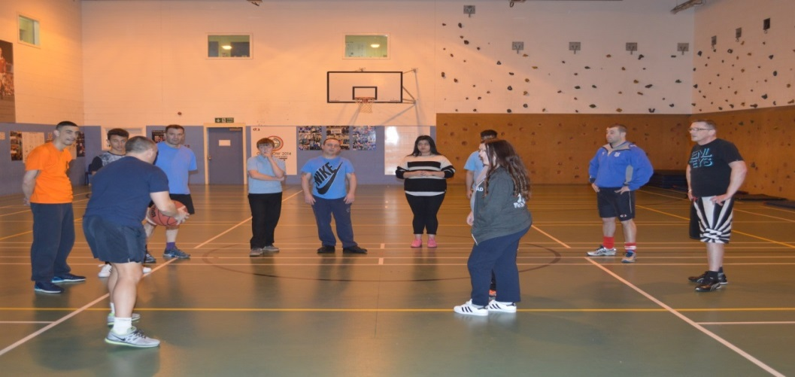
D of E Bronze Award: HMP Parc since - 2014

Slide 15
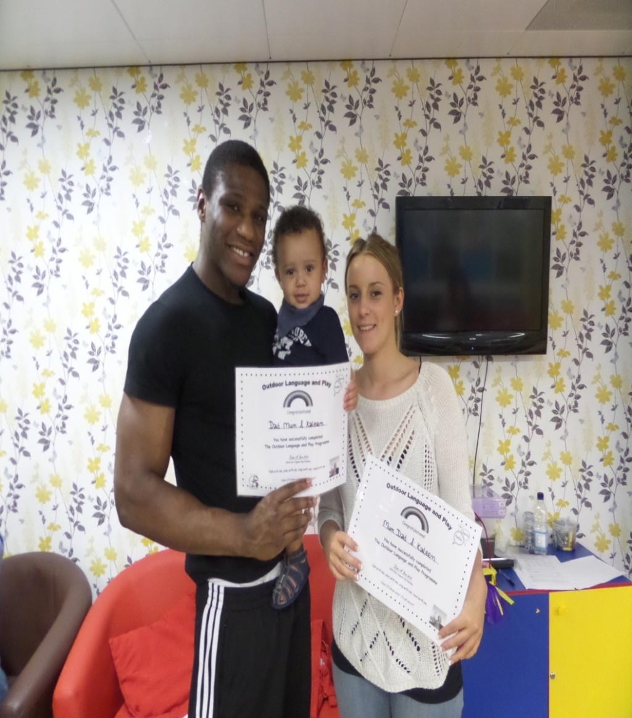
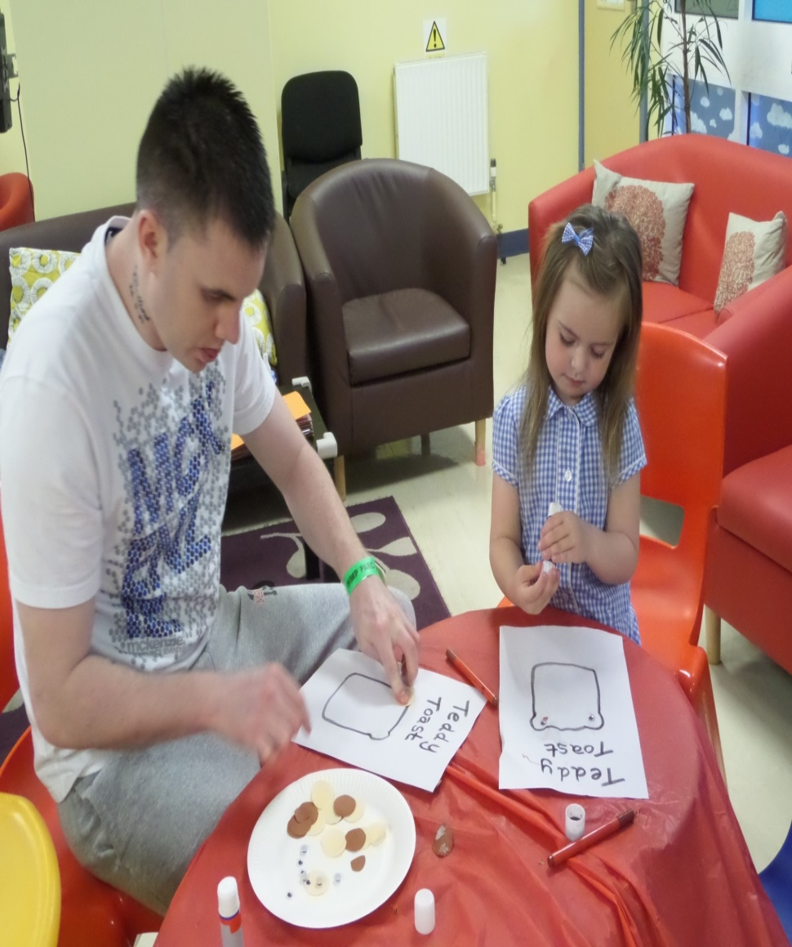
Language & Play + Numbers & Play
in partnership with Local Authorities since 2012

Slide 16
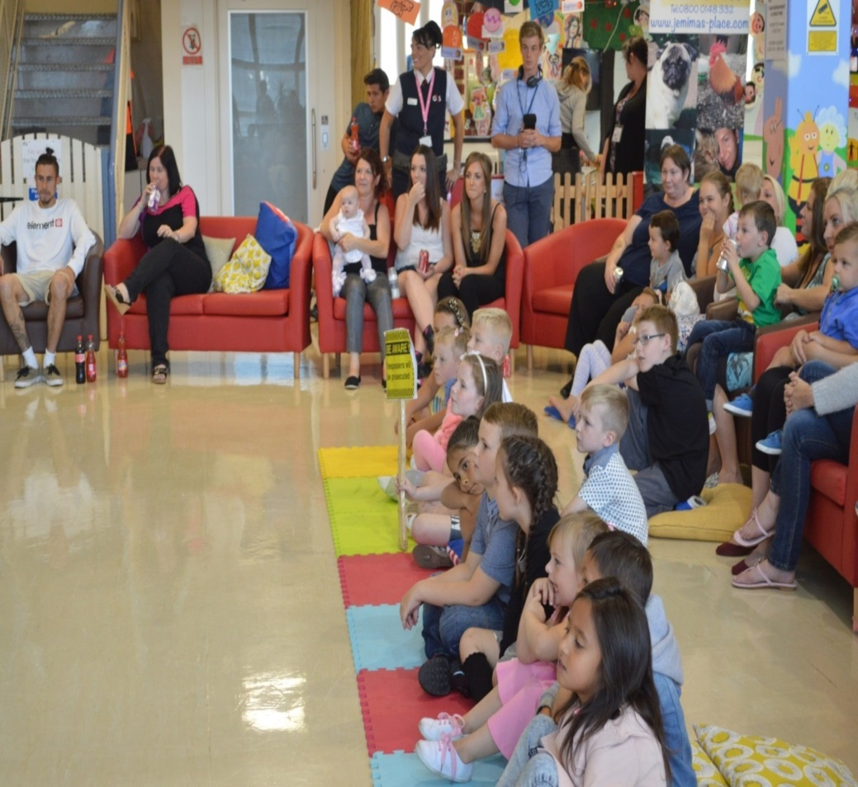
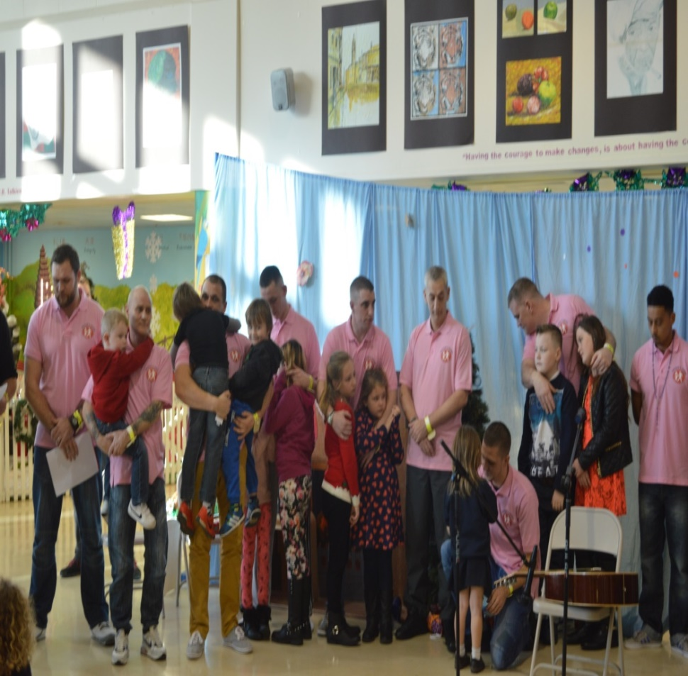
‘Family Man’ & ‘Fathers Inside’:
In partnership with Safe Ground UK since 2010

Slide 17
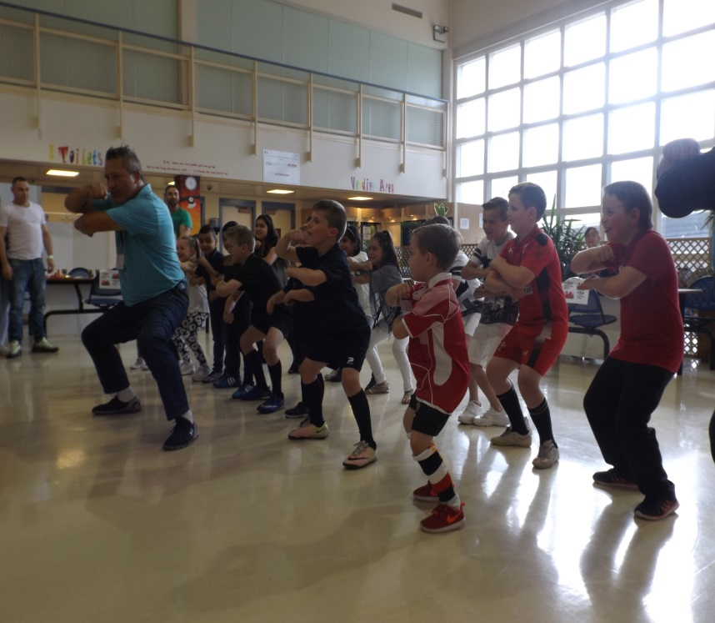
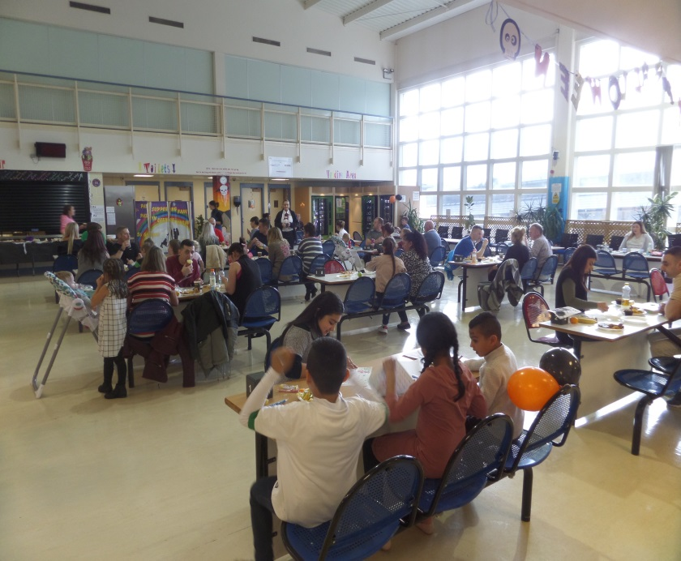
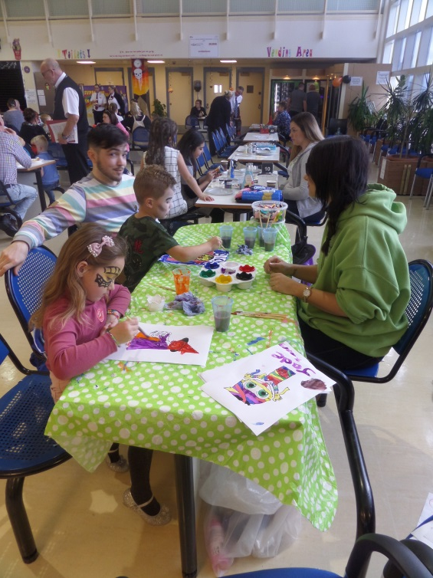
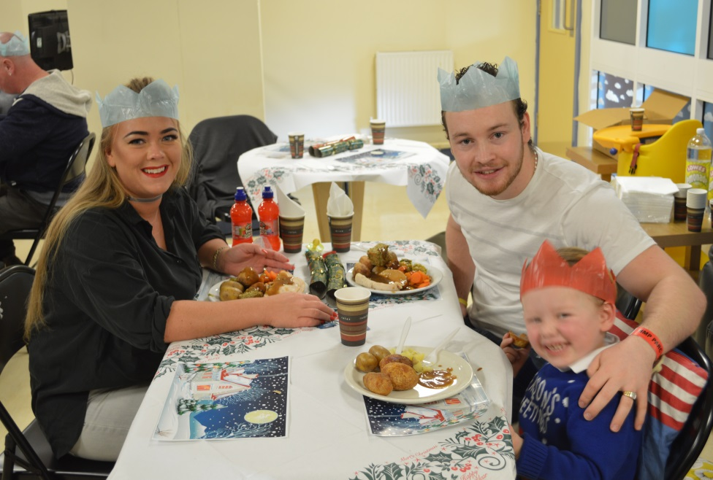
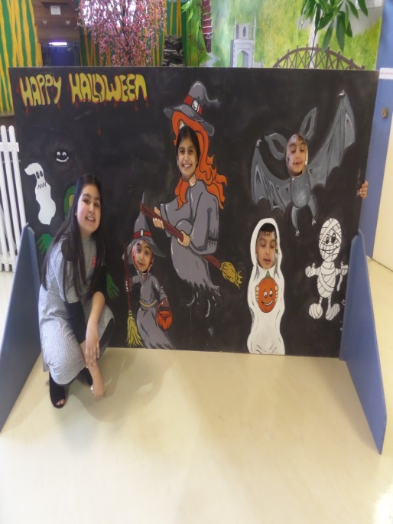
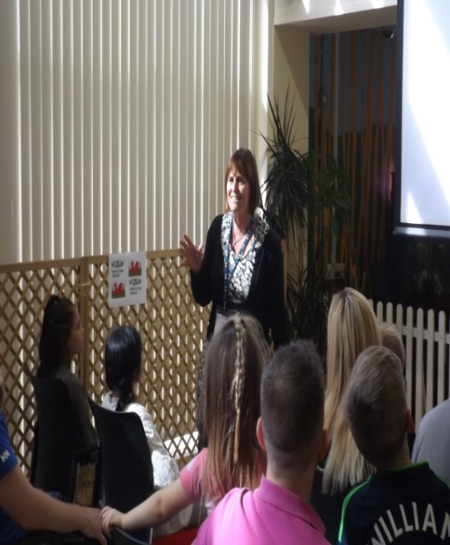
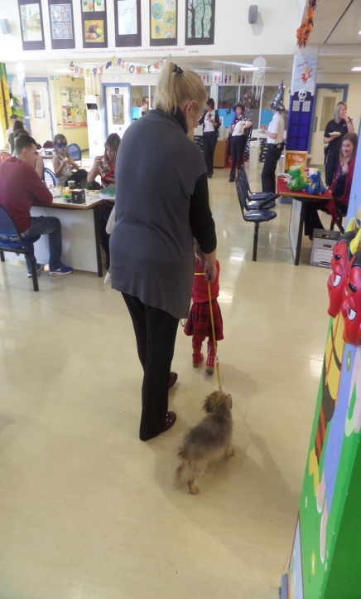
Family Day Events…Throughout the year

Slide 18
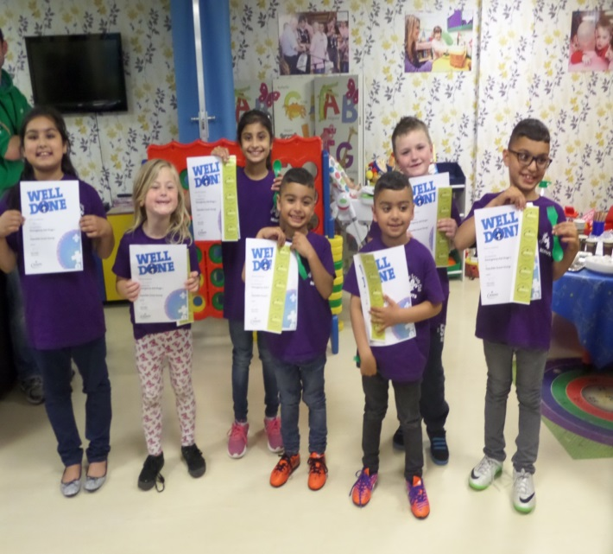
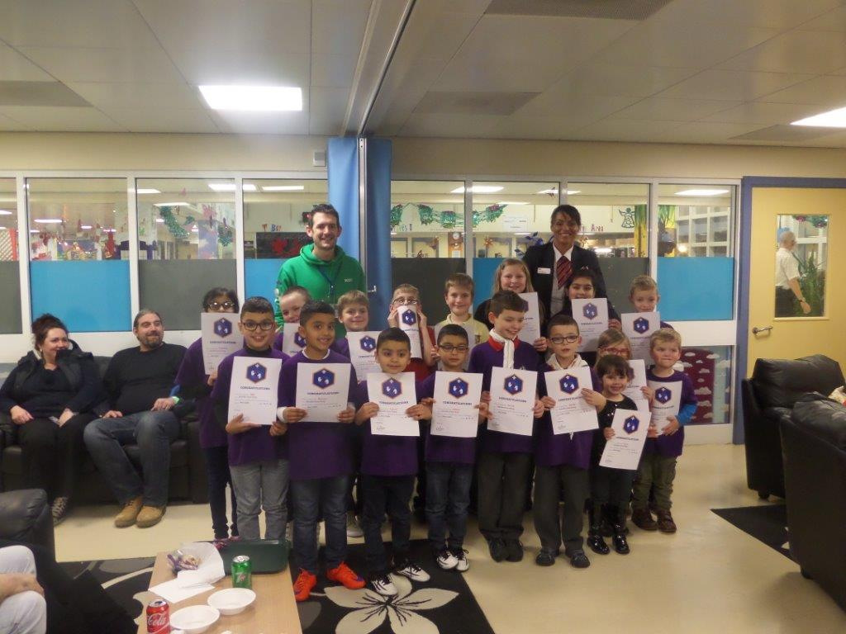
Positive family re-engagement:
Scouts Wales: At HMP Parc
Glyndwr Scouts Club
Founded 2014…
Still growing…

Slide 19
‘Knowing is not enough. We must apply. Willing is not enough. We must do.’
Bruce Lee

