Slide 1
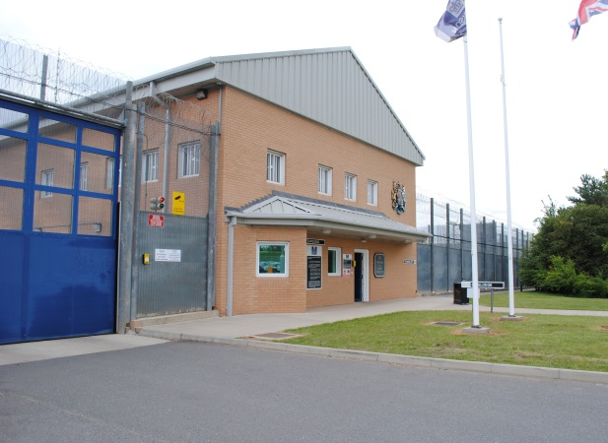
DEVELOPING EFFECTIVE PRACTICE FOR FAMILIES AND SIGNIFICANT OTHERS
28th February 2018 Newbold Revel
Developing innovative practice in a sensitive Public Protection environment
Lynn Saunders OBE Governor HMP Whatton

Slide 2
Themes of Presentation:
Farmer Review
People with Sexual Convictions – Safeguarding, not all family relationships are positive
Negotiating the challenges
“What can we do for people who don’t have family support?”
Conclusions and Questions
Contact details

Slide 3
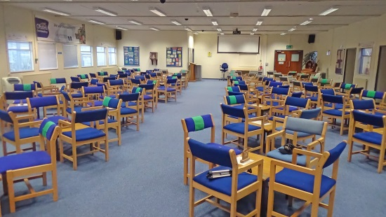
Lord Farmer Review
“The Importance of Strengthening Prisoners' Family Ties to
Prevent Reoffending and Reduce Intergenerational Crime ”
Extensive research shows that strong links between; a supportive family and desistance and supporting prisoners throughout their sentence and their rehabilitation after release.
Extensive desistance literature on the role of families in helping people successfully resettle and stay crime free.
BUT

Slide 4
Not all family relationships are positive or helpful:
Family members maybe direct or indirect victims of a prisoners offence.
- “90% of sexual offending victims know their offenders” (MoJ, 2017)
Family members or significant others may contribute or enable a prisoners offending.
- “Denial of offence and refusal to believe it took place” (Pogrebin, 2004)
Prisoners may be subject to harassment orders, restraining orders, or public protection restrictions in respect of family members.
Family relationships may have broken down due to the nature of the offence.
- “Family members accepted the offence and rejected the individual” (Pogrebin, 2004)

Slide 5
Negotiating the challenges:
Public Protection and safeguarding children and vulnerable people must always be paramount
Ensure that there is always a victim (or potential victim,) perspective in any strategy/ policy or decision (effective risk management).
Develop services to support the needs of family members:
Visitors Surgery
Case workers,
Liaison with Safer Custody
OMU, (Offender Management Unit)
Programmes (post programme reviews)
Disclosure,
MAPPA (Multi Agency Public Protection Arrangements)
Family Liaison Officers for Palliative and End of Life care

Slide 6
Negotiating the challenges:
Impact of sexual offence conviction on Family – stigma, embarrassment, financial loss
Geographical Distance – video calls, prisoner voicemail and email a prisoner

Slide 7
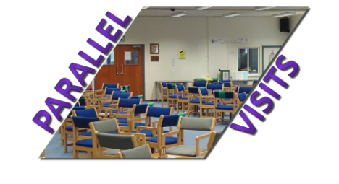
“What can we do for people who don’t have family support?”
Parallel Visits – new project utilising peer support and staff/prison volunteers
New Bridge
Prisoners’ Penfriends
also…

Slide 8
“What can we do for people who don’t have family support?”
Circles of Support
Safer Living Foundation
Through the Gate mentoring and support on release.

Slide 9
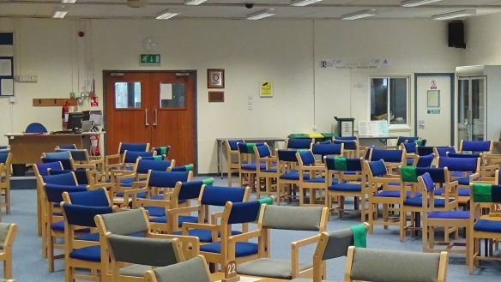
Conclusions & Questions
Families should where possible, be at the forefront of prisoners resettlement and rehabilitation, and the challenges of public protection and safeguarding can be managed with imagination, enthusiasm and commitment.

Slide 10
Thank you for listening.
Contact Details:
lynn.saunders@hmps.gsi.gov.uk
http://saferlivingfoundation.org
Follow us on twitter

