Slide 1
Family and significant others conference HMP Askham Grange
5 March 2019

Slide 2
Our Strategic Objectives
A prison and probation service that reforms offenders by:
Maintaining the highest level of public protection
Keeping prisons safe, secure and decent
Supporting offenders to reform
Reducing reoffending

Slide 3
What are we here to do?
All of us work to make a real difference to the lives of others and, in doing so, protect the public.
Openness
All of us must exercise our authority wisely and with integrity, with decisions that are fair and consistent.
Our job is to deliver the sentence and orders of the courts safely and securely, within a culture of decency and respect that enables rehabilitation.
As colleagues we innovate, share and learn as we develop and improve our professional practice with investment and trust in the skills of our staff to do their jobs well
Together we work as a team to protect the public and reduce reoffending.
As an employer and as colleagues we respect and value everyone and look to motivate everyone to be the best they can be.

Slide 4
Why it matters…
“Family and significant relationships are considered as a key means by which we can prevent reoffending and reduce the likelihood of intergenerational crime. Supporting a prisoner in a meaningful and constructive relationship with his or her family or significant others, should be a primary focus for anyone caring for those in custody who hope to achieve positive change and transform lives.”
*Quote from Delivering Effective Family Practice Operating Guidance issued December 2017

Slide 5
Why it matters…
“I've learned that people will forget what you said, people will forget what you did, but people will never forget how you made them feel..”
Maya Angelou
*

Slide 6
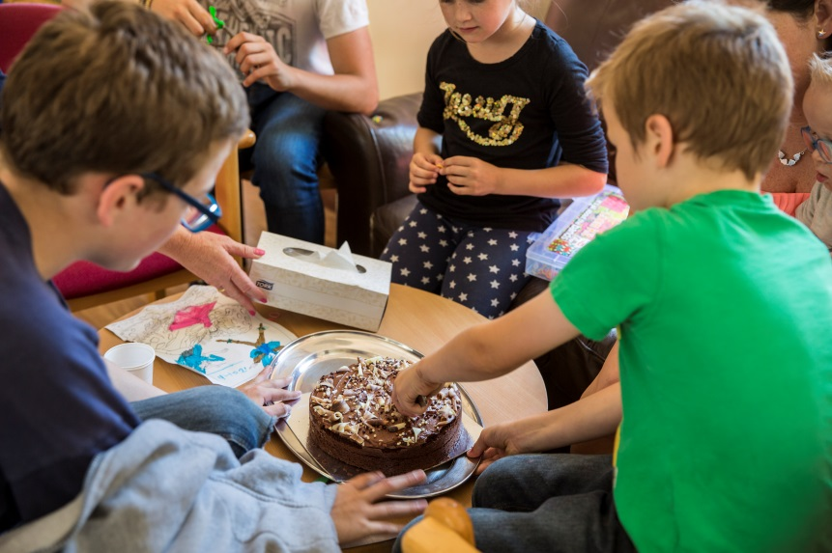
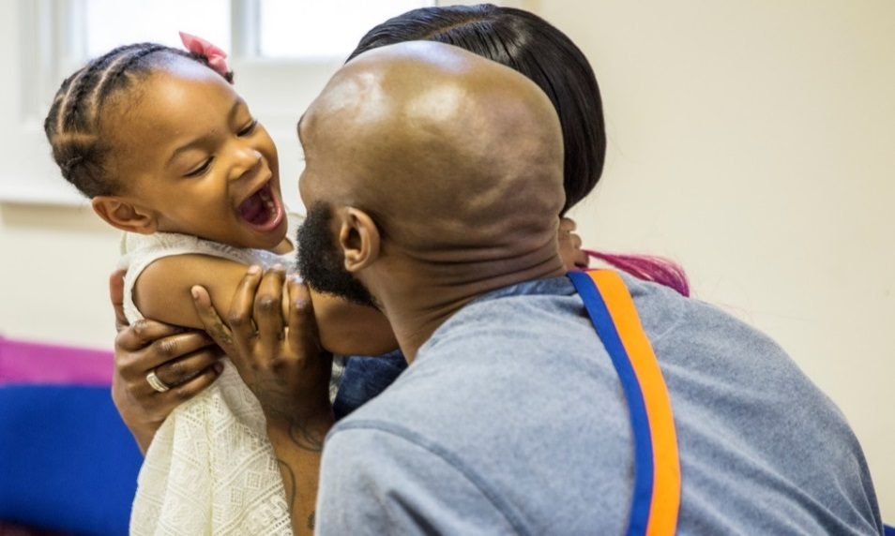
Why it matters…
“For a child I think it’s very intimidating
and scary to have to go through”
–
Parent
referring to walking through a prison with
their child on a visit
Each year, 200,000 children experience the imprisonment of a parent in England and Wales and half a million visits are made by children to public prisons

Slide 7
Why it matters…
Prisoners who receive visits from family members are 39% less likely to reoffend
Reoffending rates are 21 percentage points higher for people who said they had not received family visits whilst in prison compared to those who had*
Around 43% of prisoners lose contact with their families
Only three in ten prisoners reported that it was easy or very easy for family to visit them at their current prison – 16% said they did not receive visits*
*Statistics taken from Bromley Briefings Prison Factfile Autumn 2017

Slide 8
Did you know?
The Assisted Prison Visits Unit Contact Centre has provided an ‘in house’ bespoke visits booking service since 2011 and recently expanded to 22 public sector prisons.
A contact centre approach was developed to allow legal/official visitors to use both email and phone service and social visitors both online bookings (24/7 availability) and phone calls – not losing that personal interaction.
In 2018 we made over 100,000 bookings on behalf of prisons
Handled around 200,000 calls relating to prison visits
Our USP:
Opening hours from 9am – 6pm Monday to Friday
Front and Back office approach to ensure all business areas - legal and social visits requests are met
Birmingham based location and economies of scale will reduce staffing costs which could be reinvested into family work.
If you would like to know more…
Please speak to us here today or contact APVU at APVU Management in the GAL

Slide 9
Did you know?
The Assisted Prison Visits Scheme contributes towards the cost of travel to prison visits. It is open to close family members and significant others who are on a low income and allows for one visit every two weeks.
During January 2019 the Assisted Prison Visits Scheme contributed to the cost of 2983 unique visits.
The average cost per visit was £33.11
Customers can claim directly online at gov.uk/helpwithprisonvisits.

Slide 10
Lord Michael Farmer
Lord Michael Farmer is a Conservative Peer who advocates government policy and services which strengthen family ties as a way to help people to realise their potential.
Background:
Made Conservative Party Life Peer in 2014
Chair of Farmer Review on Importance of Strengthening
Prisoners' Family Ties to Prevent Reoffending and Intergenerational Crime
Partner and contributor to the Strengthening Families Manifesto to integrate the importance of family across all government departments
Senior Partner at RK Capital Management
Sponsor Governor Ark All Saints Camberwell
“I do want to hammer home a very simple Principle of reform that needs to be a golden thread running through the prison system and the agencies that surround it. That principle is that relationships are fundamentally important if people are to change. ”

Slide 11
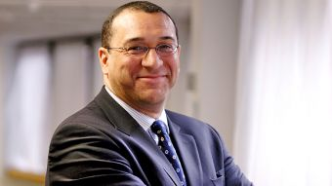
Digby Griffith – Executive Director Rehabilitation and Assurance
Digby Griffith is Executive Director, Public Sector Prisons at HM Prison & Probation Service. Digby Griffith joined the Home Office in 1988. He was appointed as Director, National Operational Services at the National Offender Management Service (NOMS) in 2011.
His previous roles include
Director, Offender Management for London, (NOMS)
Head of Security Group, NOMS
Director, Immigration Enforcement, Home Office
Director, National Asylum Support Service, Home Office
Head of Parole in the Prison Service, Home Office
“We intend to make a clear commitment in our HMPPS business plan to family and significant other work”

Slide 12
Family Strategies Working Group
The success of the family agenda is supported by a small team which include the following colleagues:
Richard Booty – Operational Families Lead
Graham Mackenzie – Policy Family Lead Head of APVU
Tim Lloyd – Head of Assisted Visits Prison Unit
Dr Angela Herbert MBE – Family Advisor
Stuart Harrington – HMPPS Family Communications lead -Seconded to Barnardo’s
FSWG associate:
Richard Nicholls – Head of Operations CLINKS
Policy leads and colleagues with specialist knowledge also contribute to the families agenda to enable positive engagement and relationships between prisoners’ their family and significant others.

Slide 13
Our partner organisations
Barnardo’s Sodexo Justice Services
Choices Consultancy Services Spurgeons
FAST VCSG
FoPP (Sodexo) YJB
G4S
HALOW
JIGSAW
LAT
NEPACS
Ormiston
PACT
POPs
PSS
SERCO

Slide 14
Please feel free to Tweet about:
#askhamfamiliesconference

