Slide 1
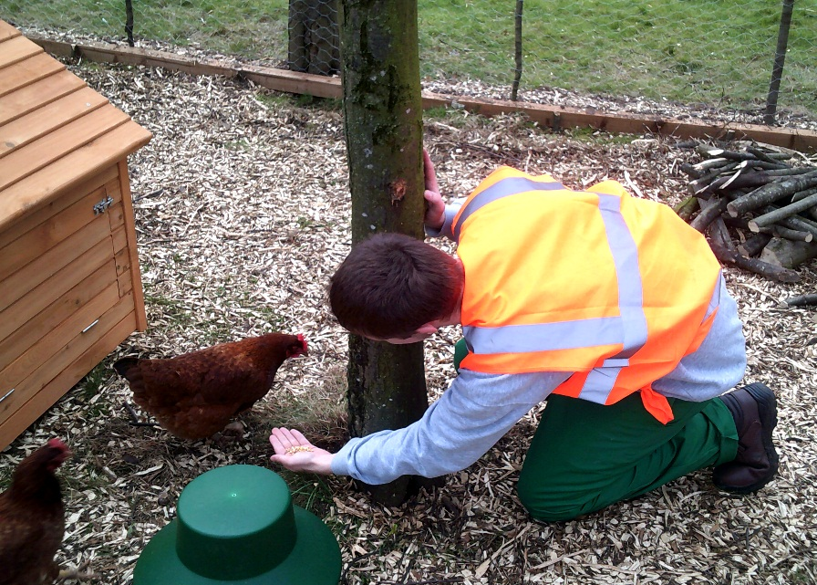
CARE EXPERIENCED PEOPLE – FAMILY AND VERY SIGNIFICANT OTHERS
Debbie McKay – Operational Lead for Care Experienced People (HMPPS)
Notes:
Introduce self – you will need to put your names on this!
Explain been asked to speak about national agenda – will be very brief due to time!
Photo there to remind people that this is about a group of individual people – when we discuss national agenda we can often forget about the people who sit behind it

Slide 2
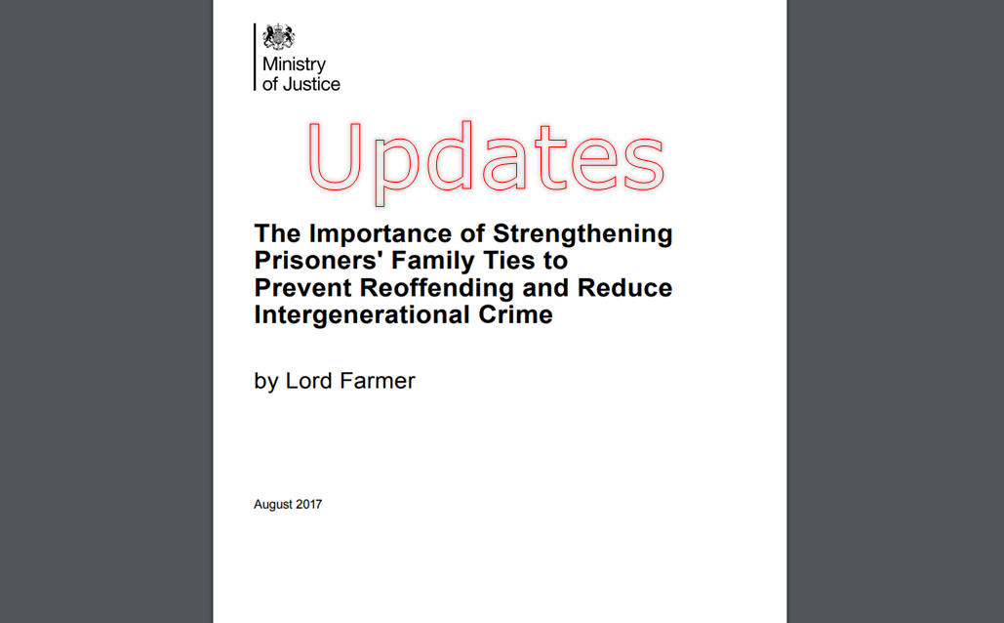
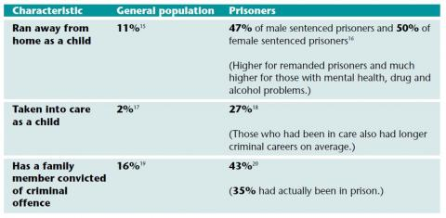
Why is this important?
“Care Leavers are more likely to have experienced significant trauma and abuse and other disadvantages that can put them more at risk of violence, self- harm and suicide when in prison. Many come to prison feeling extremely isolated and angry”
Care Leavers Association – “Effectively Abandoned”

Slide 3
Family – what does that look like? Well it’s complicated……
“All my brothers and sisters have been in foster care... Our relationship is kind of awkward because we don’t really know each other”
Coram Voice – Rapid Review
“What does Family look like? It might be your mates mum. It’s other credible voices, someone who can give you a seal of approval”
Farmer Review
“Seeing my mum, it was like, are you really mum? Like it gave me mixed emotions cos I love her but it’s difficult because I don’t want to show her too much affection for her to just drop it like she did before”
Coram Voice – Rapid Review
“They (Foster Carers) are part of your life, your history and part of the reason you are who you are. They’ve taken you in when you had nothing of when the situation in your life was so dire and that means something”
Coram Voice – Rapid Review

Slide 4
Corporate Parents – the role of the local authority and personal advisors (PA)
“My 16 plus worker is like my mum. I
am still in contact with her. hugs when
I’ve done well, lectures when I’ve done something wrong ... I wish I didn’t have her as a social worker, I wishshe was my friend”
Coram Voice – Rapid Review
“I don’t know how to describe it, we’re not mates, I know we’re not mates because she has got to be professional. But, at the same time, like I know I can talk to her about anything… she’s always willing to listen and at the same time she gets in touch with me”
Coram Voice – Rapid Review

Slide 5
Visits and maintaining contact
“ I haven’t had any [visits]. I would like to see [my social worker] because I would like to be kept up to date with what’s going on outside. I don’t know what is happening”
“Visits give you a connection to the outside world. There is no escape otherwise” Lord Farmer Review
“I’m just so happy to see someone! I can’t stop smiling when my social worker is here because I don’t get any
other visits and it’s just nice
to keep in touch with the outside world”
Coram Voice – Rapid Review

Slide 6
Other considerations
“I’ve never been able to trust anybody, because I have been moved about so much. I’ve never really had that type of bond with my mam or any of my foster carers or anything like that, to be able to open up and speak to them and trust them. I’ve put trust in people before and they’ve just let me down because I have been moved about so much, so, my wee motto is: don’t trust nobody but yourself, and in that way you can’t go wrong. If you don’t need
to trust anybody, nothing’s going to go wrong and you can’t get hurt..”
Coram Voice – Rapid Review
“We may need to work harder to help our care leavers form relationships and to form relationships with them ourselves”
Wolverhampton Corporate Parenting Council
“A looked after child may have been moved constantly so cannot point to any one consistent person who supported them. A series of temporary homes can mean no home at all”
Wolverhampton Corporate Planning Guidance

Slide 7
CONTACT ME ON ….
Debbie.mckay@hmps.gsi.gov.uk
For more information
Notes:
You can add to this or bin it!

