Slide 1
A VOICE FOR ALL
Danielle – A Family Perspective
Notes:
1 mins
Introduce presenters

Slide 2
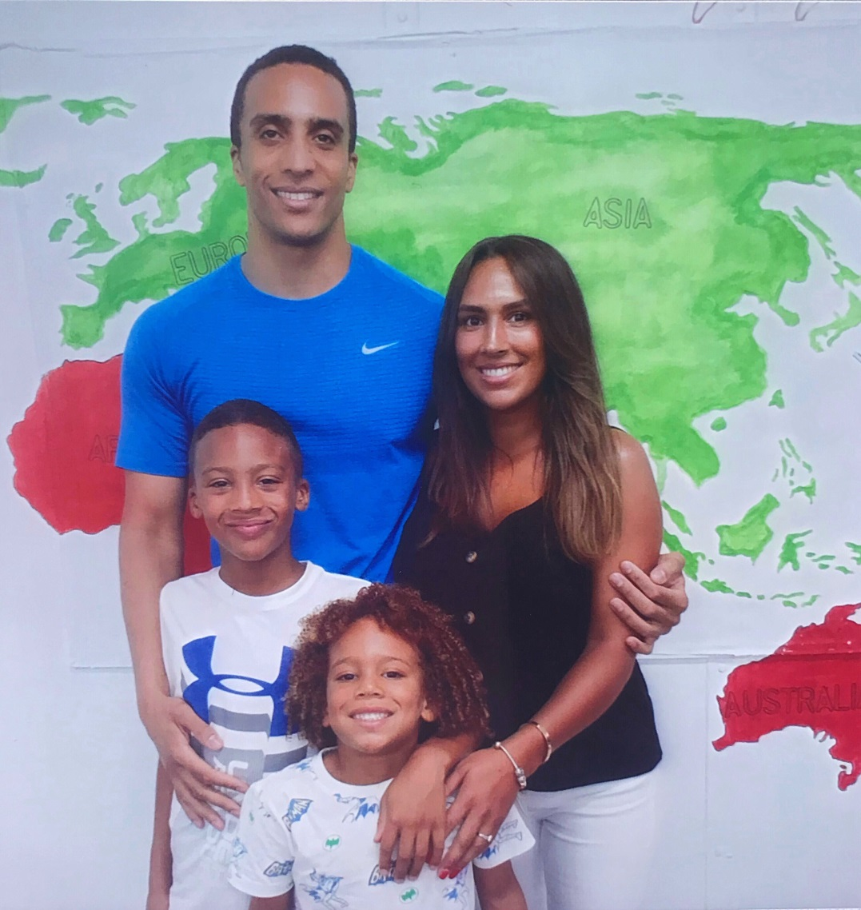
Our First Family Day

Slide 3
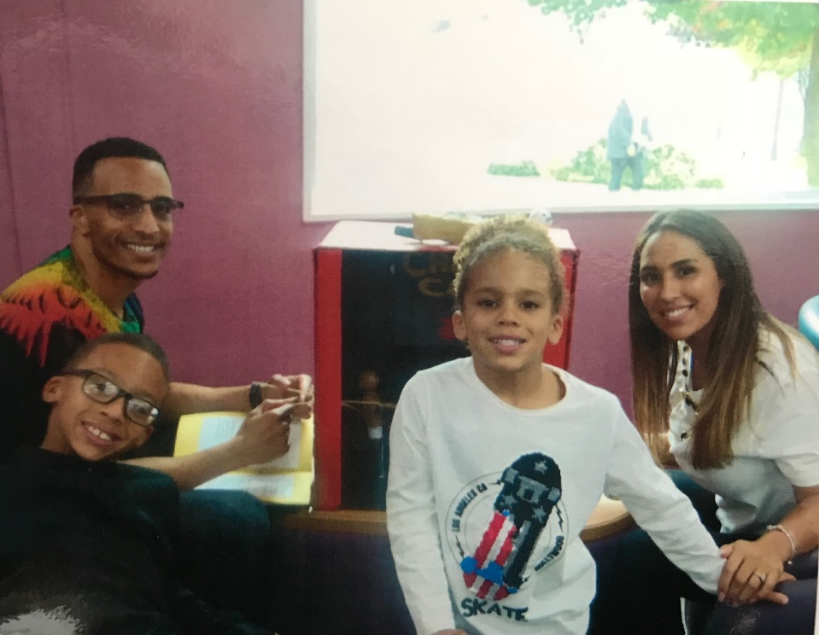
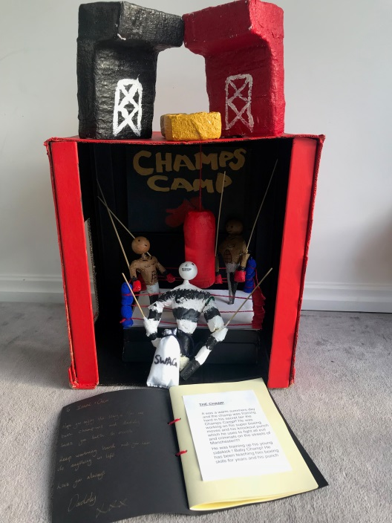
Parental Contact Visit

Slide 4
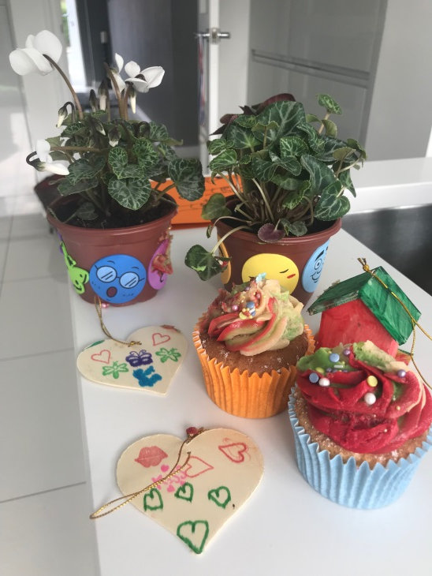
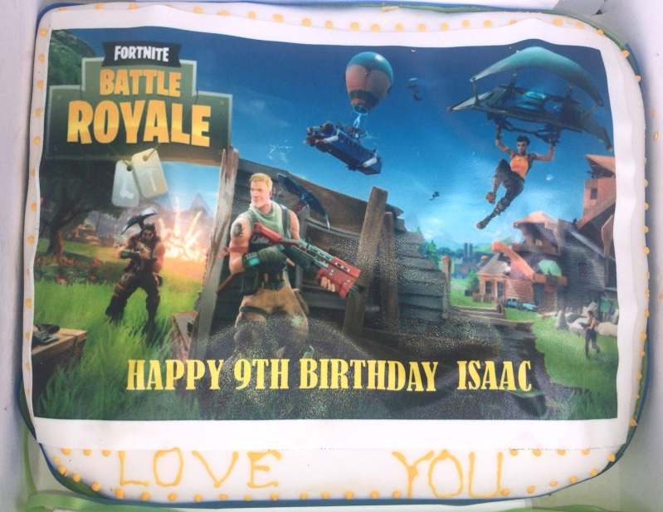
Marcus Being Involved In Our Special Occasions

Slide 5
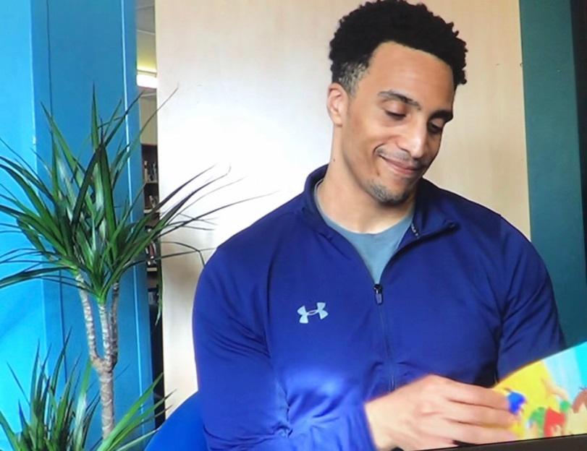
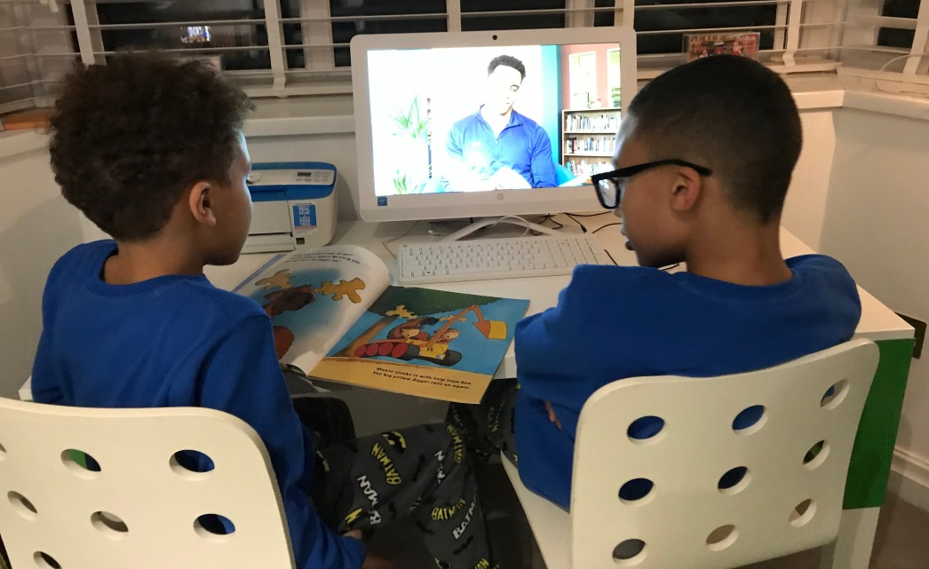
Story Time With Dad

Slide 6
Christmas Family Day 2018

Slide 7
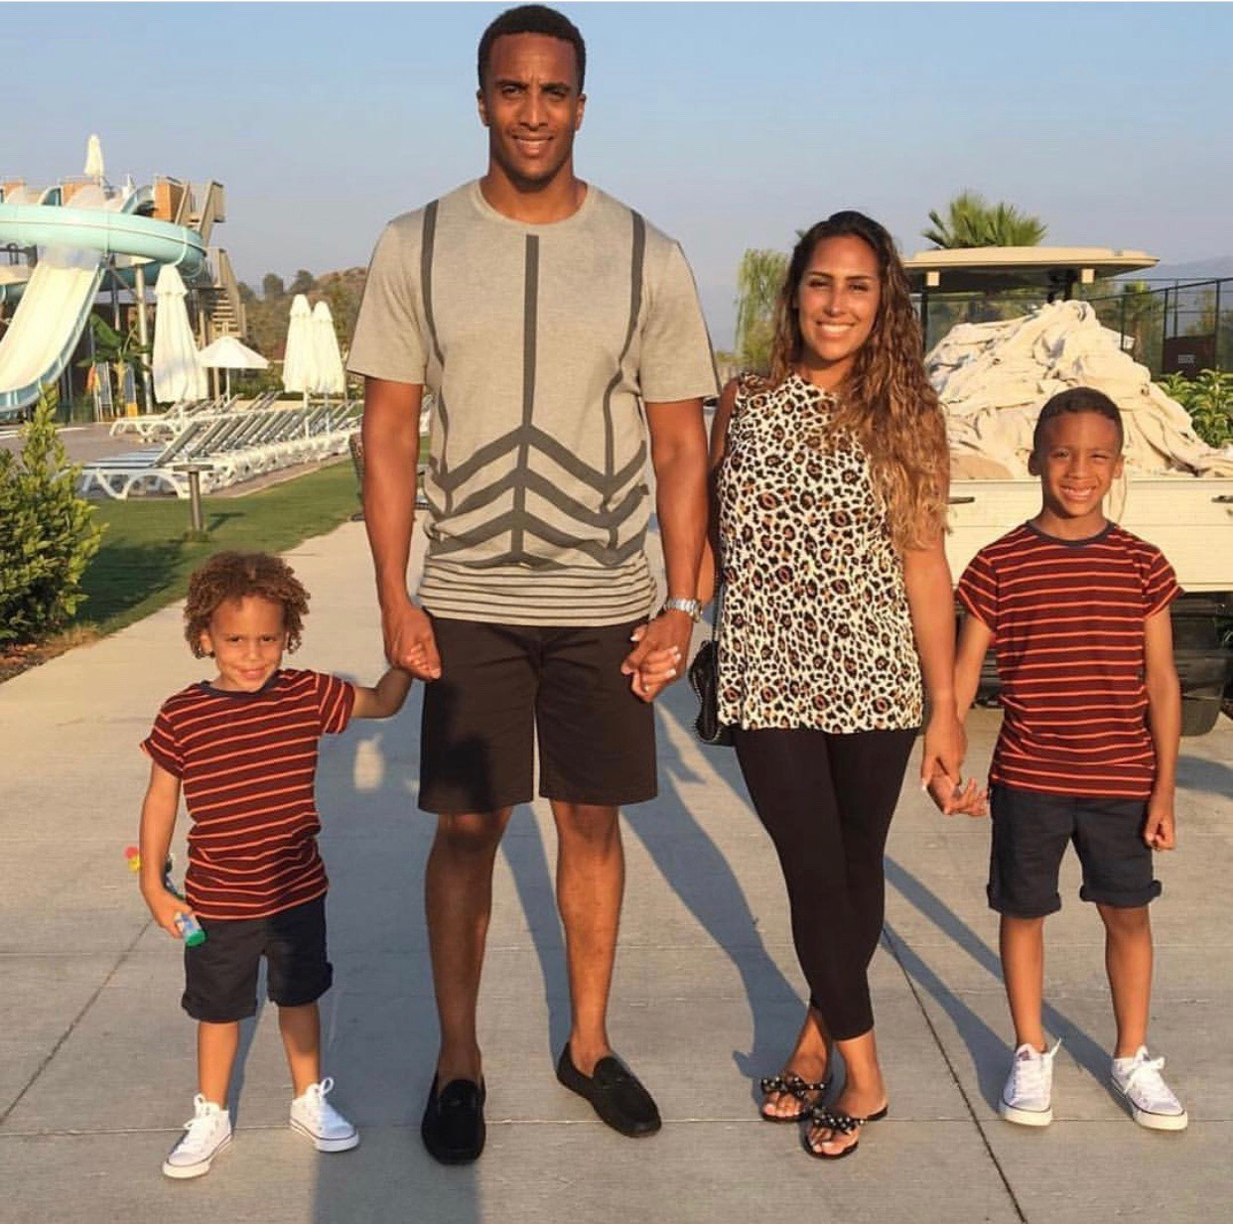
Thank You For Listening

