Slide 1
The follow-on Farmer Review: Strengthening female offenders’ family and other relational ties
Lord Farmer, Keynote speech
HMPPS/Clinks 2nd Developing Effective Practice for Families and Significant Others National Conference.
Askham Grange, 5th March 2019

Slide 2
The ‘original Farmer Review’:
The simple principle of reform that needs to be a golden thread running through the prison system and the agencies that surround it...that relationships are fundamentally important if people are to change.

Slide 3
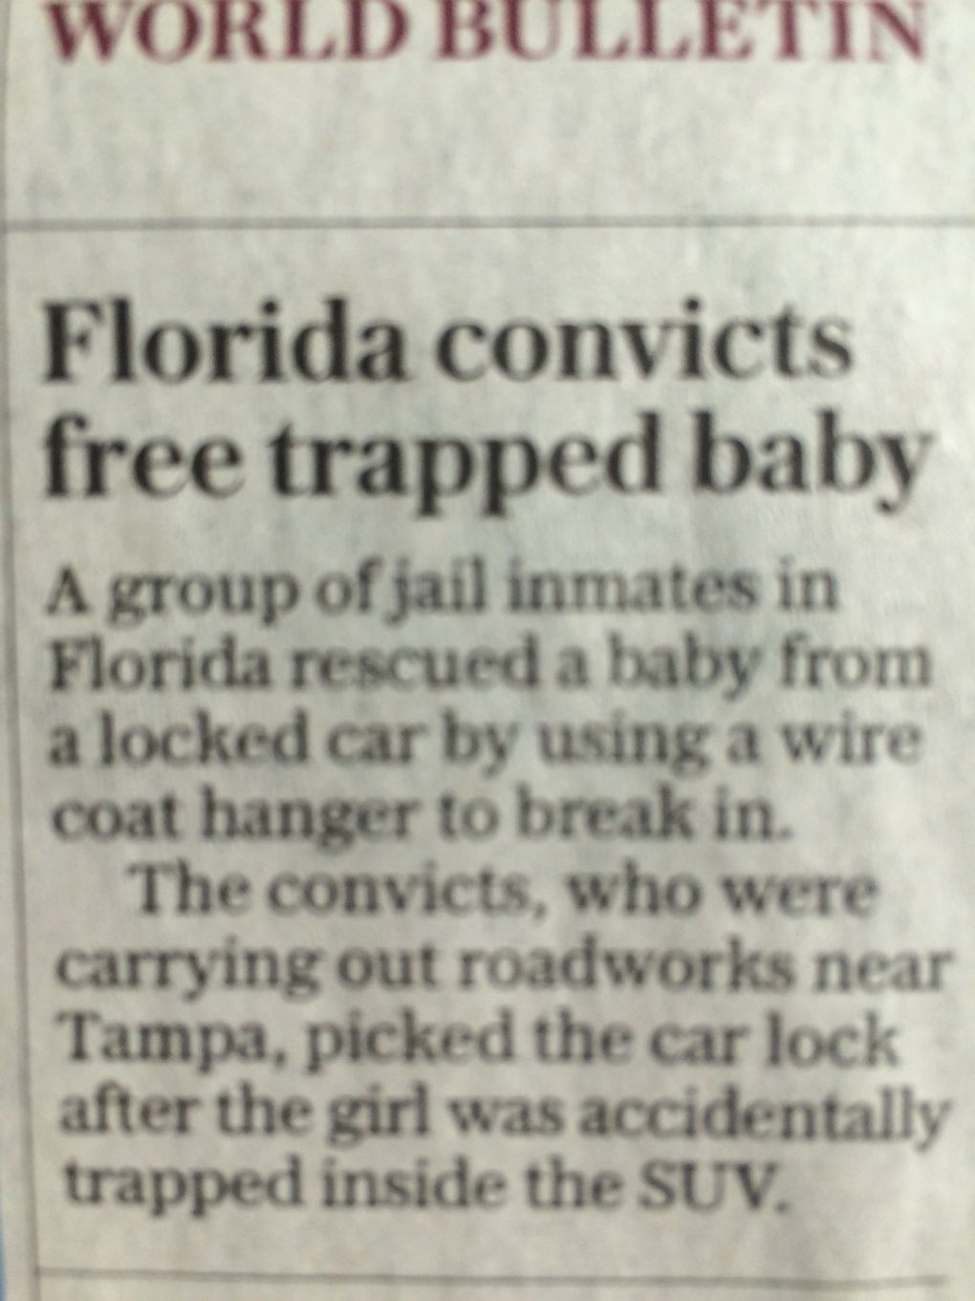
The public IS interested in prisoners

Slide 4
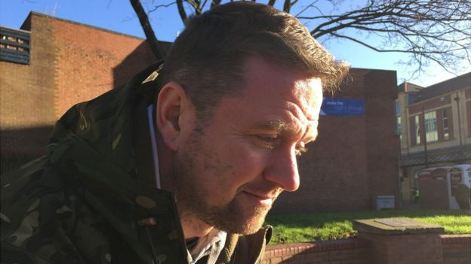
…and their family lives:
‘The murderer who's opening a youth centre’

Slide 5
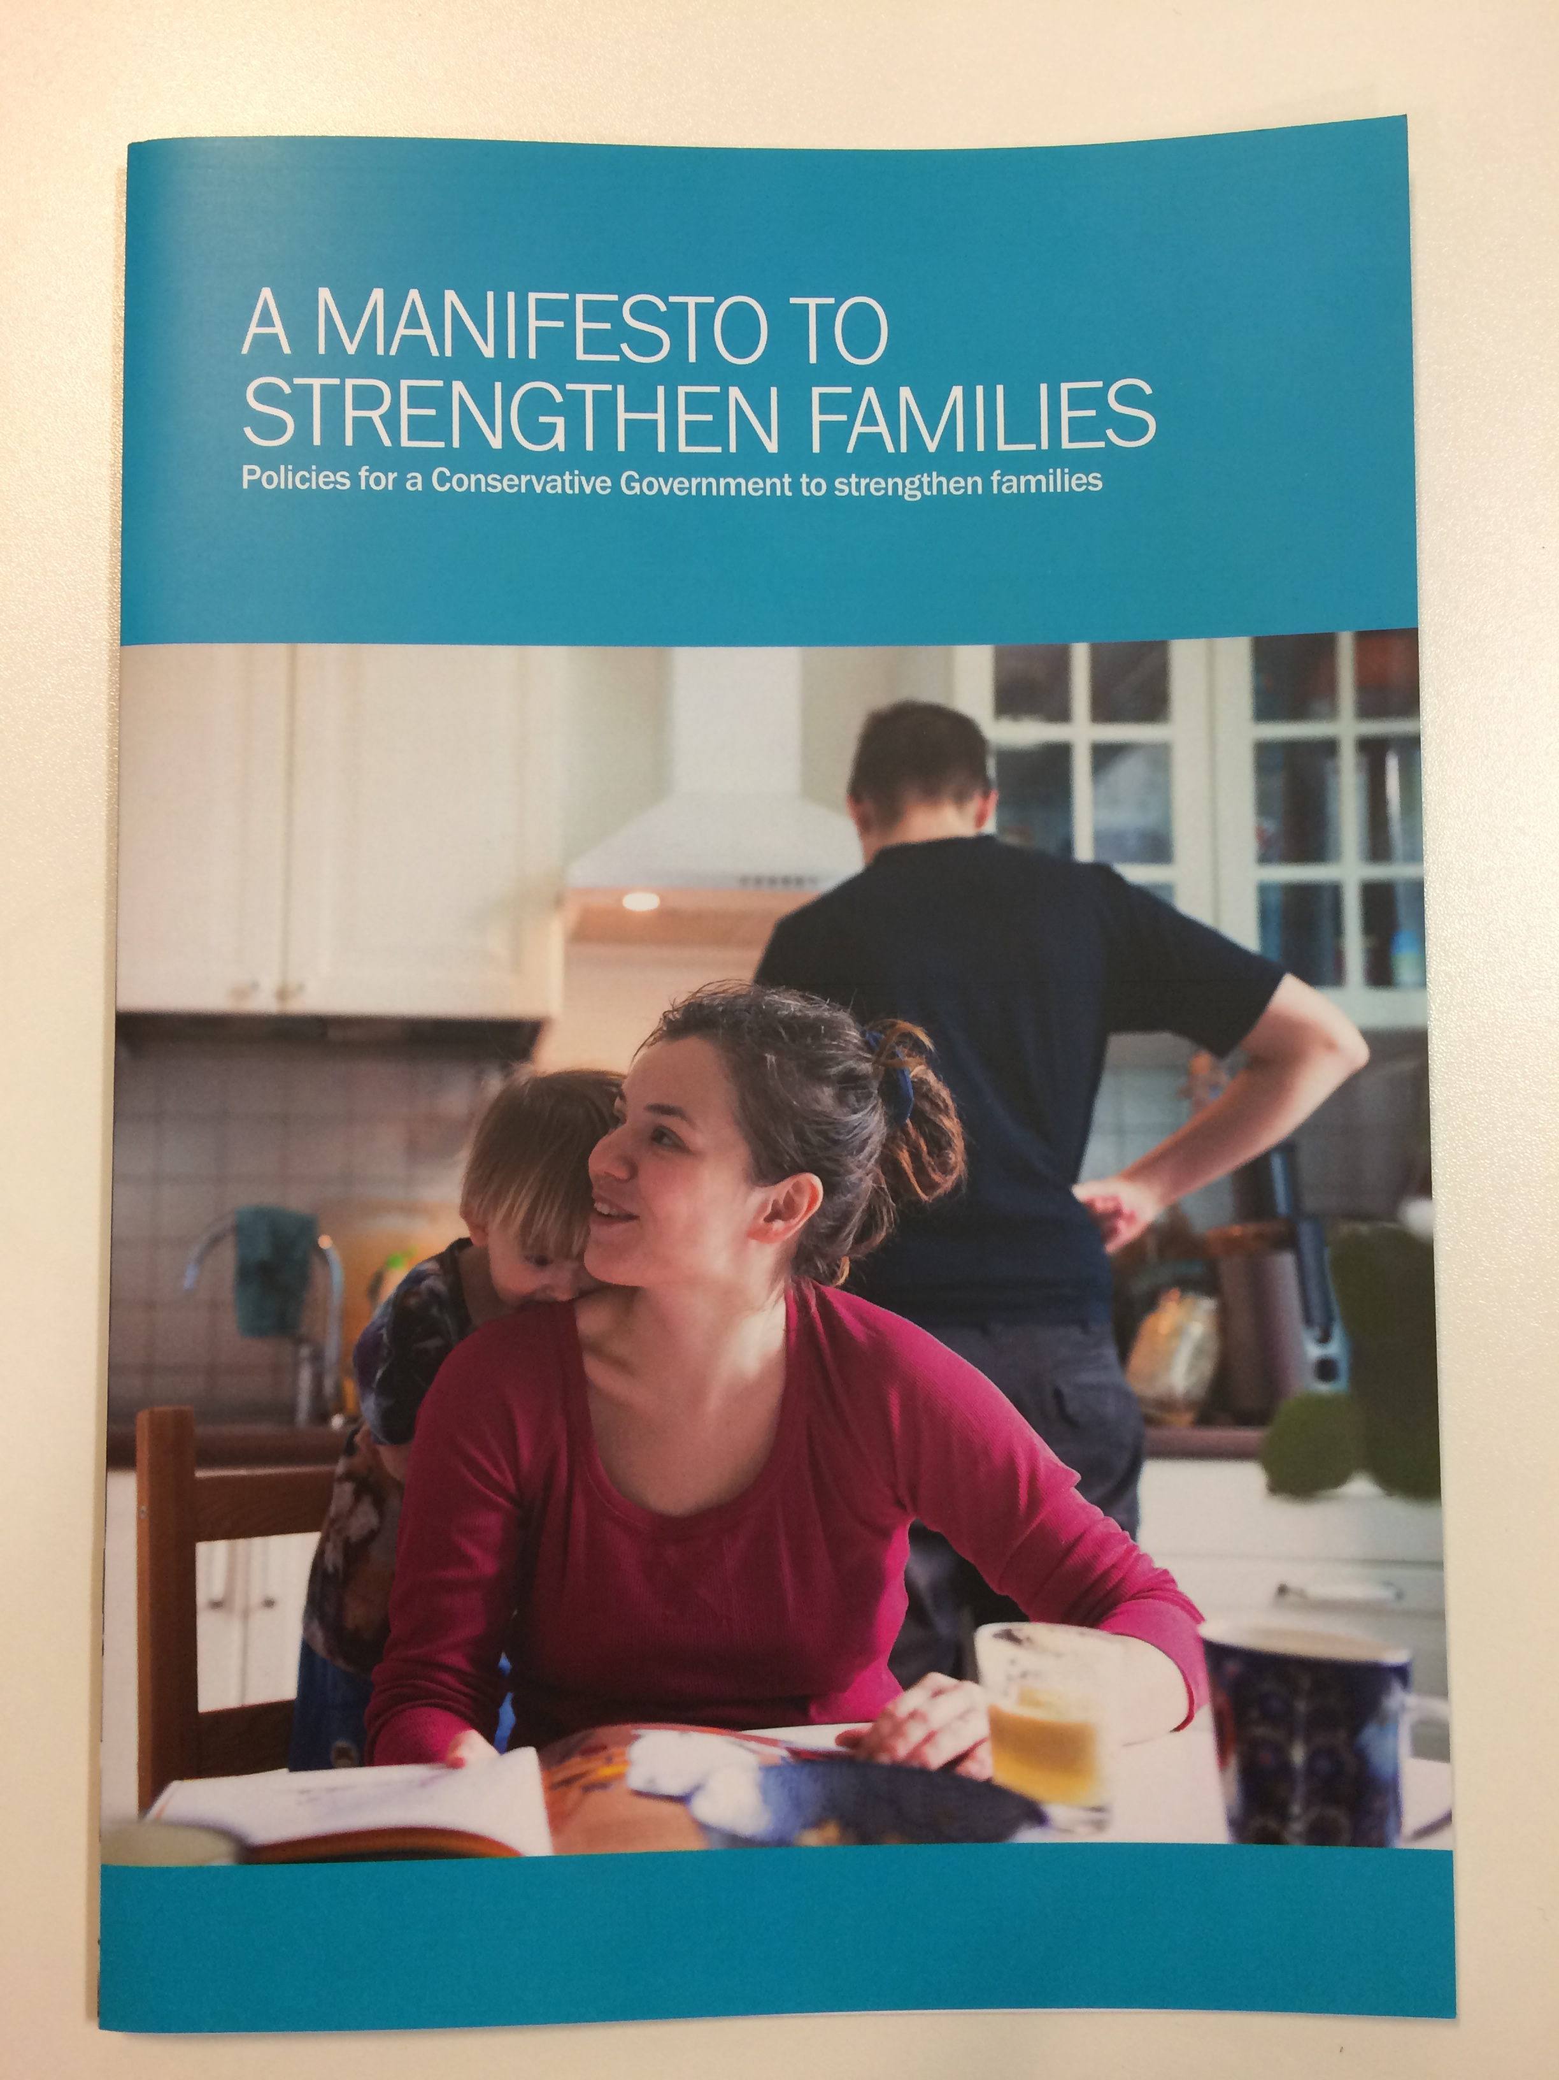
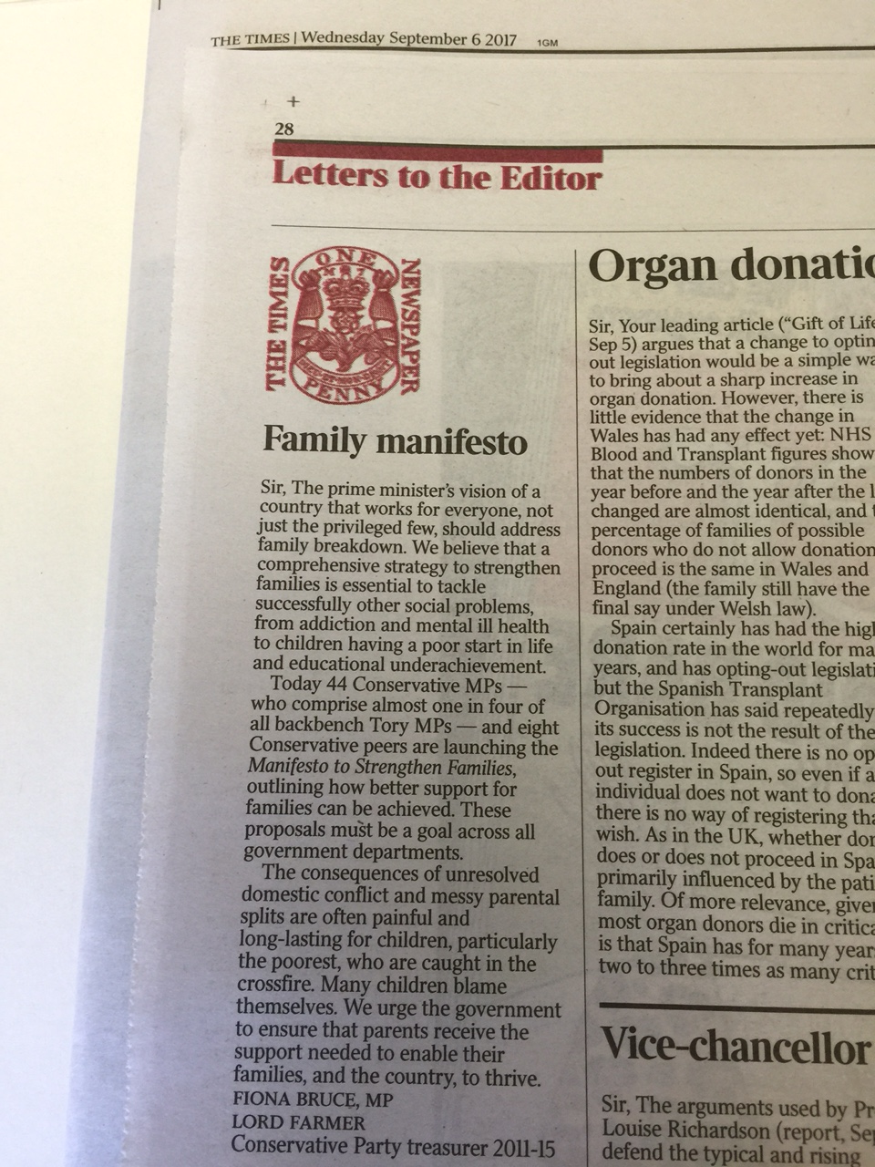
Manifesto to Strengthen Families

Slide 6
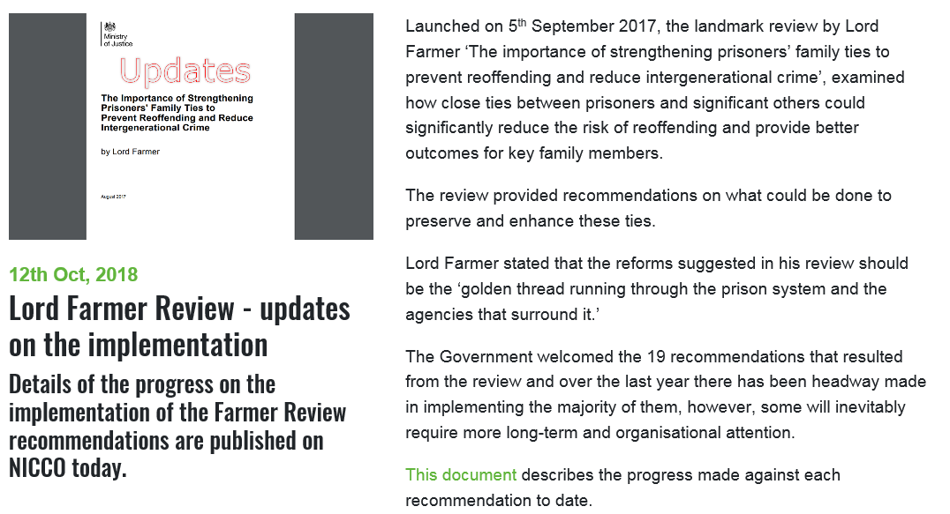
1. Importance of having an implementation plan (Part I) https://www.nicco.org.uk/news-and-views/lord-farmer-review-updates-on-the-implementation

Slide 7

2. Why a follow-on Review was needed – the different needs of female offenders

Slide 8
3. Family services going through the gate
Wherever a woman finds herself in the criminal justice system we need to do more to ensure her relational needs are met:
Work to maintain and improve family and other relational ties …can provide meaning and all-important motivation to other strands of [rehabilitation] activity.
It also has proven success in preventing reoffending in its own right and should always be seen and referred to alongside work and education as the third leg of the stool that brings stability and structure to offenders’ lives.

Slide 9
The different needs of female offenders
‘Women are more vulnerable’
Relationships are women’s most frequent criminogenic need – 75% of all offenders, 85% of those serving short sentences have a relationship need.
(It’s still high for men: 63% of all male offenders)
Women are more likely to be primary carers:
  Their family-related needs are more complex
Intergenerational transmission of crime is higher
Family relationships are more likely to be toxic
Visits are more difficult to make happen and trickier
  They should be prioritised for virtual visits

Slide 10
Family services Through the Gate
Family and relationship support should also be a minimum requirement for resettlement
Need to address Catch 22 of securing accommodation BEFORE regaining day-to-day care of children
Opportunity to influence Probation Review currently underway
‘Help with parenting and relationships must be standard in diversionary pathways and community sentences that ensure root causes of crime are dealt with so women do not come near the courts or enter custody.’

Slide 11
Implementation (Part II)
HMPPS and I are pushing for improvement but we want to help make that happen
Inspecting for progress – frinstance, do you want to become a more extrovert prison?
Let’s work together to
  Innovate
  Inspire good practice elsewhere in the UK and abroad and
  Improve beyond all expectations the outcomes for offenders and their families

Slide 12
Thank You!

