Slide 1
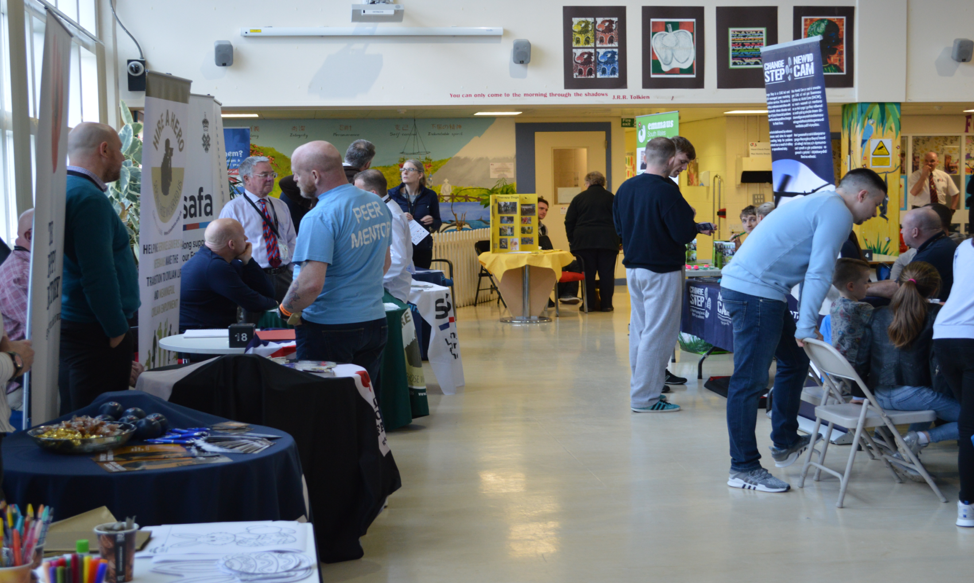
Community Partnerships :
Bringing the outside inside…
Unit Endeavour

Slide 2
Discussion Question: 1.
Discuss & List - What are the challenges for a prison in establishing community partnerships?

Slide 3
Discussion Question: 2.
Discuss & List - What realistic solutions could be generated to overcome the challenges you have identified?

Slide 4
Key barriers to stakeholder engagement
Culturally & strategically unimportant
Lack of financial resource
Limited staff to implement
Limited space & facilities
No clear accountable lead
Inexperience of stakeholder engagement
6
5
4
3
1
2

Slide 5
1. Culturally & Strategically Unimportant : suggestions…
Research, understand, accept – Government endorsed international evidence base that FI are a key causal factor in reducing current and next generation offending.
Embed priority documents into your strategy e.g. LF Recommendations, HMIP Expectations, HMPPS Guidance.
Integrate FI strategy across departments – create synergy with RR strategy, substance misuse, safer custody, L & S, security, etc.
Identify and promote interdepartmental benefits
Once the cultural Rubicon is crossed… don’t relax!

Slide 6
2. Lack of Financial Resources: suggestions…
Identify and protect the Governor devolved budget for FI (2017)
Innovate income generating opportunities – eg visits & VC café, (Britannia HMP Norwich) become a training venue (Hidden Sentence).
Develop a bid submission ability, as an establishment, and as a partner
Map relevant local/national community cross sector organisations – host community awareness events in the visits hall.
Identify mutually beneficial objectives – joint submissions eg BIG Lottery, Local Authority slippage, Community Grants, etc.
Nurture and protect your new friends in your partnerships.

Slide 7
3. Limited Staff to Implement : suggestions…
Successful partnership bid submissions usually create new staffing capacity to deliver.
Successful internal income generation, creates/ frees up staff for FI
Successful interdepartmental relations identifies staffing slack, to redistribute, op’ and nonop’… Essentially more efficient staffing model.
Develop / evolve your volunteer strategy, including vetting & training. Partnerships with local universities, CLINKS, volunteer bureau, Erasmus, etc. Volunteers are a huge untapped seam of skilled, enthusiastic, and free resource.

Slide 8
4. Limited Space & Facilities : suggestions…
Most underused and overlooked space in the prison… visits facility.
Identify the down time to create FI opportunities.
There is always down time! (1750 – 77% - 6000+) Analysis of visiting trends, respond to supply and demand.
View and use the visits facility as a custody & community resource.
Be creative and bold with other prison areas where safe to do so. FI in the gym, library, Multi-Faith, open-air spaces, etc

Slide 9
5. No Clear & Accountable Lead : suggestions…
Identify a clear and accountable lead!
Tagging this strategy and responsibility onto someone’s existing role, who does not posses the sufficient rank, clout, experience, or personality is pointless, and will fail.
Be strategic, choose carefully who is given the senior accountability, someone who can then identify and enable a team to champion FI.
Look after them!

Slide 10
6. Inexperience of Stakeholder Engagement : suggestions…
A successful and sustained attack on steps 1 – 5 will largely negate this barrier.
In so doing, you will develop stakeholder engagement that is specific to the needs of your establishment.
As the stakeholder engagement process embeds and grows… protect it jealously!
Promote and celebrate partnership successes using approved media platforms.
Once the cultural Rubicon is crossed… don’t relax!

Slide 11
The HMP Parc FASO strategy is supported by 147+ partners …

Slide 12
What advice would you give a prison trying to develop community partnerships?
Safe Ground UK: Charlotte Weinberg CEO
“Be honest and set up a relationship of clear trust and direct communication. Manage expectations from the get go and be very wary of people who promise what seems impossible- question it and trust your gut. Be open and request feedback, take it and use it to inform your own development. Be curious and demand excellence.”

Slide 13
What advice would you give a prison trying to develop community partnerships?
Prison Voice Mail: Kieran Ball CEO “I’ve been pondering this all day, it’s hard to put all of my thoughts into a single quote! How about this:
Getting Prison Voicemail into 110 prisons took a complex combination of cold emails and calls, formal and informal introductions, tweets, conferences, letters to ministers, and sheer persistence. This would have taken a fraction of the time if only each prison had a designated partnerships contact with contact information publicly available and up-to-date. A simple but significant step towards making prisons more approachable for service providers.”

Slide 14
What advice would you give a prison trying to develop community partnerships?
Dutch Prison Service – Director of Rehabilitation: Fokko Drent
“Identify agencies and organisations that best suit your prison culture. Make sure you select motivated and enthusiastic prison staff who can make a difference. You will really need them! Carefully connect with local government, social teams, probation, voluntary organizations, local universities and so on. Together you have to find a way to introduce the family approach in prison.
Connect with the prisoners and their families, tell them you as a prison are committed to making a difference for the future. Remember it is not easy or quick to do this… but here we have now seen the first results and it is worth it!.”

Slide 15
What advice would you give a prison trying to develop community partnerships?
Families Outside UK – Nancy Loukes CEO
“Quality family contact makes the whole prison calmer and safer for prisoners and staff alike. True partnership recognises the expertise that external partners can bring, both in their work with families and their in-depth understanding of the issues families face. Prison staff also need to recognise the value of families as an asset rather than a threat to prison security - but also that supporting families is the right thing to do, not merely a tool to improve prison processes. What would you want for them if this were your own family?”
“I feel like I’m trying to pack too many ideas into a short space, but what I’m thinking about is early research I did into prison visitor centres that showed a clear contrast between centres run independently and those run by prisons. Independent services described their purpose as providing emotional and practical support, a listening ear, and a place to ‘decompress’ before and after a visit. In contrast, prison-run services (at their most extreme) described the role of a visitor centre as “a muster room for visitors to gather so that they can be processed in a quick and efficient manner.” Somehow the humanity got lost along the way, which defeats the purpose entirely.

Slide 16
What advice would you give a prison trying to develop community partnerships?
South Wales Fire & Rescue: Nicola Wheten – Community Inclusion
“For me I found it’s all in the planning, especially as there can be quite a number of restrictions when working with a secure estate. Therefore, communication is key in the sharing of such information in the first instance as this could delay the implementation of a service or intervention. As a service we were offering something unique, in the form of Fire Fighter for a Day, to the estate, which included a number of risks due operational equipment being used as part of the intervention. The implementation of this was near enough a smooth process for a number of reasons; * Our point of contact was extremely open minded and was not afraid to try something new. * I only liaised with 2 contacts only, Corin and H&S. * Decisions were made and stuck too. * Any recommendations were discussed and agreed as a partnership. * Regular feedback between all parties is essential. There is a wealth of knowledge and expertise sitting right outside those prison gates, waiting to be let in to cement together all the existing great work carried out within the prison by offering a new presence and encouragement to each individual. Get out into the community and see what they do first hand. Start those positive conversations”

Slide 17
What advice would you give a prison trying to develop community partnerships?
Wells of Hope: Uganda – Francis Ssuubi Founder
“In my opinion I would say:
Prisons are perceived as a place of torment/torture by the community, a place everyone fears.
So the prison in trying to develop partnerships with the community, has to first deal with the perceptions held by the community about the prison.
They should be friendly people, open, and encourage families to visit, work to maintain constant communication with families. The prisons should employ best customer care practices like a business would do, to show care and to show that they are there to serve the community. They should put a human heart in what they do.
Prisons should improve Prisons conditions and environment making them a place where highest level of human rights are observed.
Prisons should have a child perspective in what they do, by taking into account the needs of children of people in prison especially visitations and visiting conditions , ensuring children have regular and quality visits with their parents in prison. when the community sees that the prisons are mindful about the children of the people inside prisons, then this will draw the community closer to the prison.”

Slide 18
What advice would you give a prison trying to develop community partnerships?
Director of Welfare & Rehabilitation Ugandan Prison Service – Adam Hasiyo
“For prisons to start engaging with the community, there must be a proper framework for that. Prisons are public institutions whose mandates are clearly spelt out and boundaries of their operations set.
Secondly, there must be a deliberate effort by the institution of prison to openly state in its policy of the need to bring communities on board to rehabilitate and reintegrate prisoners. Such policy documents should in the institution strategic plans
-When policies are set, the two entities, prison and community agent, should set a conducive environment for both of them to relate.
The rest of other issues just become operational issues to be handled by the prison… nothing should be seen as insurmountable.”

Slide 19
What advice would you give a prison trying to develop community partnerships?
DC Connect – Washington State: Avon Hart-Johnson CEO
“ "DC Project Connect believes that families are one of the most effective resettlement strategies. Prisons who partner with stakeholders to develop effective resettlement interventions can contribute to reduced recidivism, increased public safety, and build healthy families which are the basic tenets of thriving communities." ~Avon Hart-Johnson, PhD, HS-BCP

Slide 20
What advice would you give a prison trying to develop community partnerships?
NSPCC – Hayley Clarke: Senior Business Manager
“Prisons who want to develop community partnerships for family intervention and support need to ensure that potential partners understand that the prison is an environment where this can happen and where they will be welcomed. I think there may be misconceptions from community based organisations that these sorts of services don’t take place in prisons and can only be offered within the community, its about building relationships with those external networks and breaking down the barriers, this might require some effort from the prison in terms of getting out there and understanding who operates in their local area, inviting people in to talk and demonstrating how others make it work e.g. Parc with its Invisible Walls programme.”

Slide 21
What advice would you give a prison trying to develop community partnerships?
CAIS Change Step: Geraint Jones – Therapeutic Director
“From a Change Step perspective, as a third sector organisation, one of the key aspects of effective collaboration is clear lines of communication. Identifying individuals as contact points across the organisations makes a significant difference, providing consistency and a basis for relationship building. As a third sector organisation we are able to provide more flexibility and added value which in turn can lead to developing new and innovative ideas.”

Slide 22
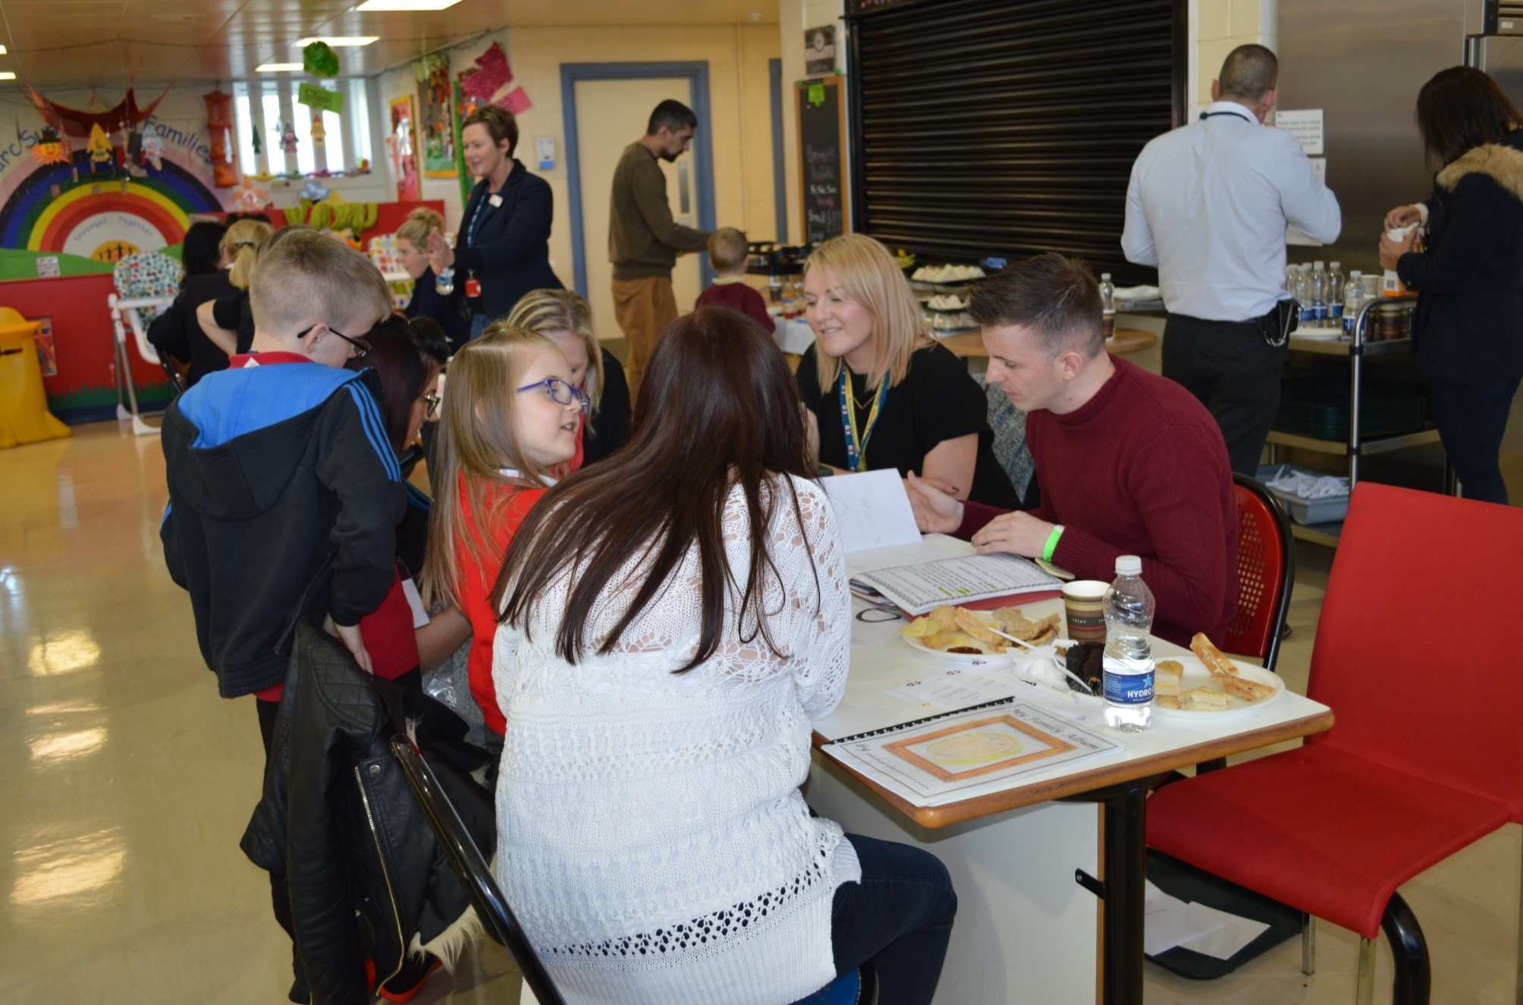
Children’s Showcase Event HMP Parc – Parent/teacher events since 2015
Son, 9 and daughter 6 years.
3 School Teachers attended for one family.
Mum and Dad said :
‘I didn’t know what to expect but it was like attending the school
The school has been so supportive throughout his sentence
The children were excited to show their school work’
Teachers Feedback
‘The children were excited to see dad
‘Good for the school to have links with dad
‘Interesting seeing their relationship with their dad
‘We had a clear outline of what was expected

Slide 23
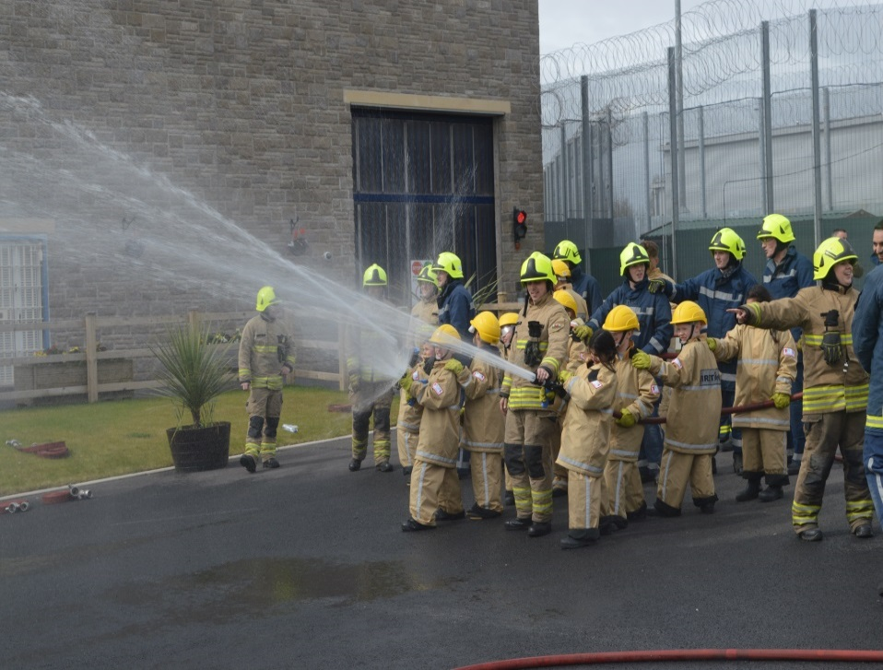
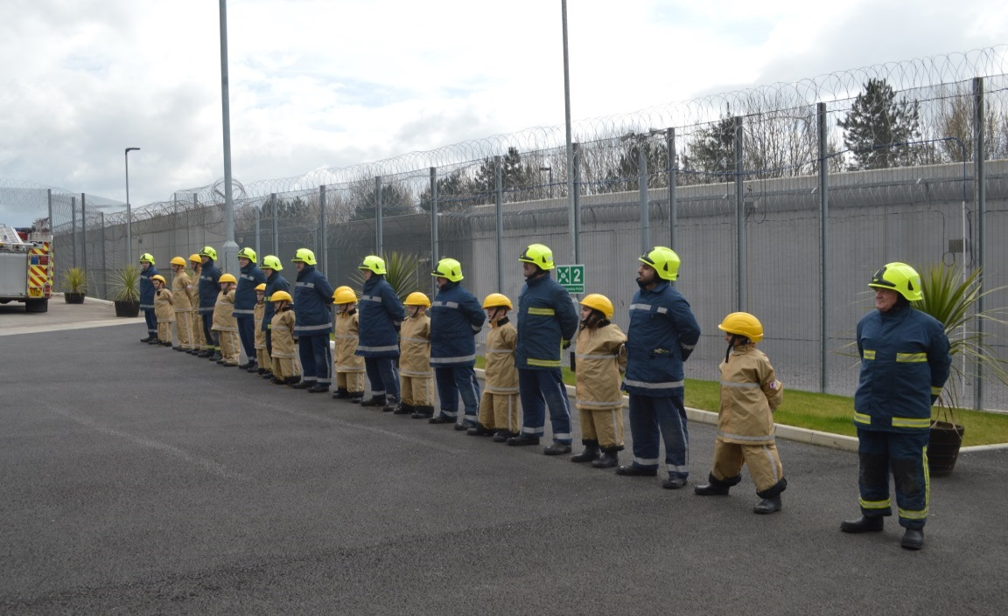
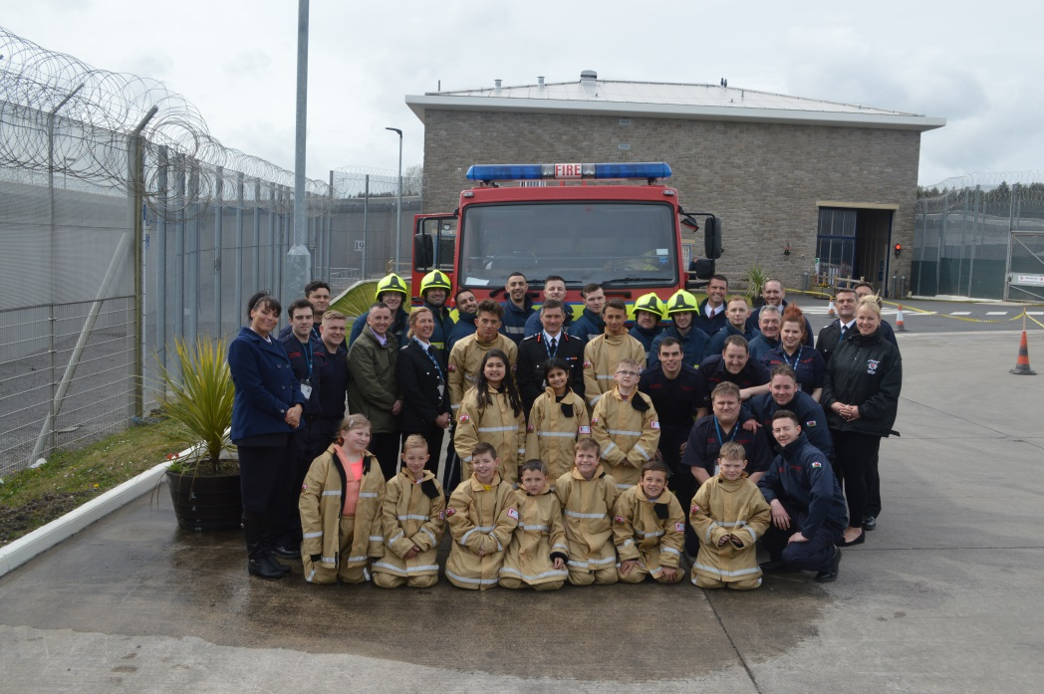
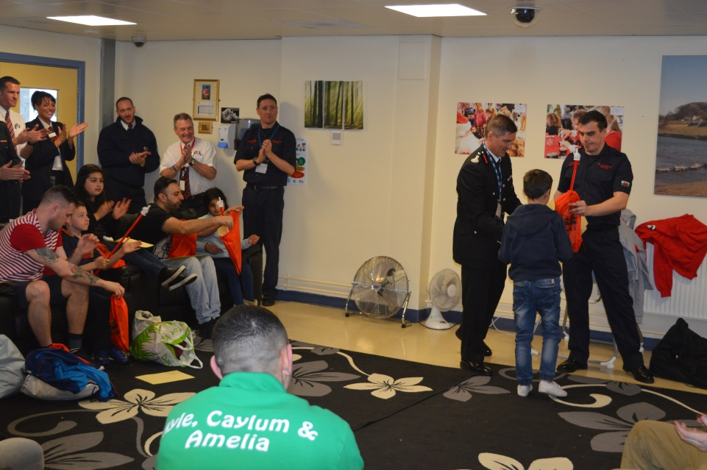
Fire Fighter For A Day – Dad’s & their children version… with South Wales Fire & Rescue Service since 2016

Slide 24
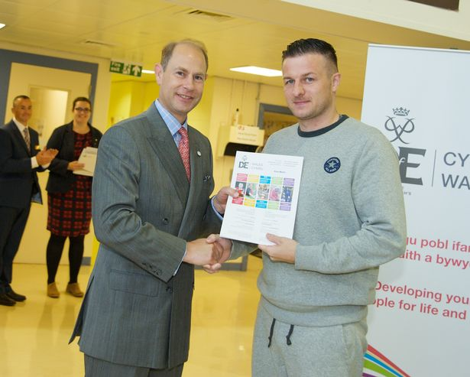
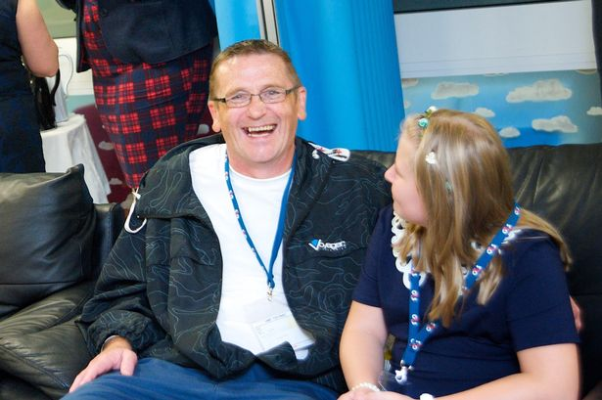
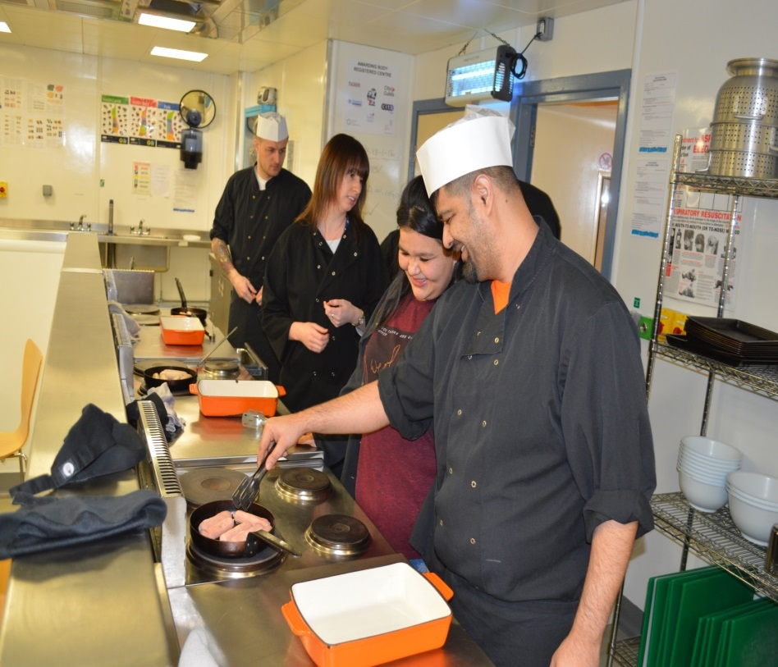
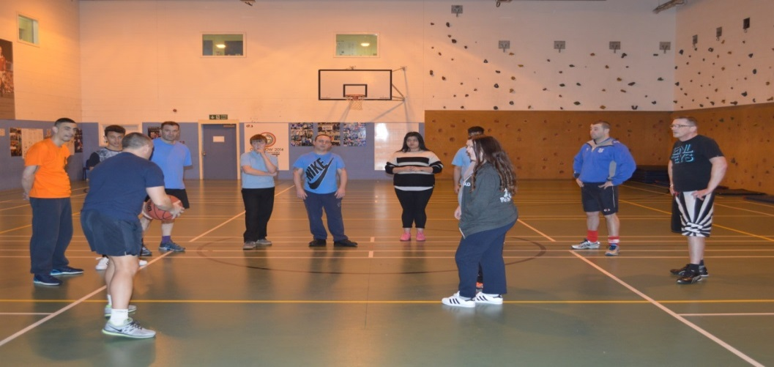
D of E Bronze Award: HMP Parc since - 2014

Slide 25
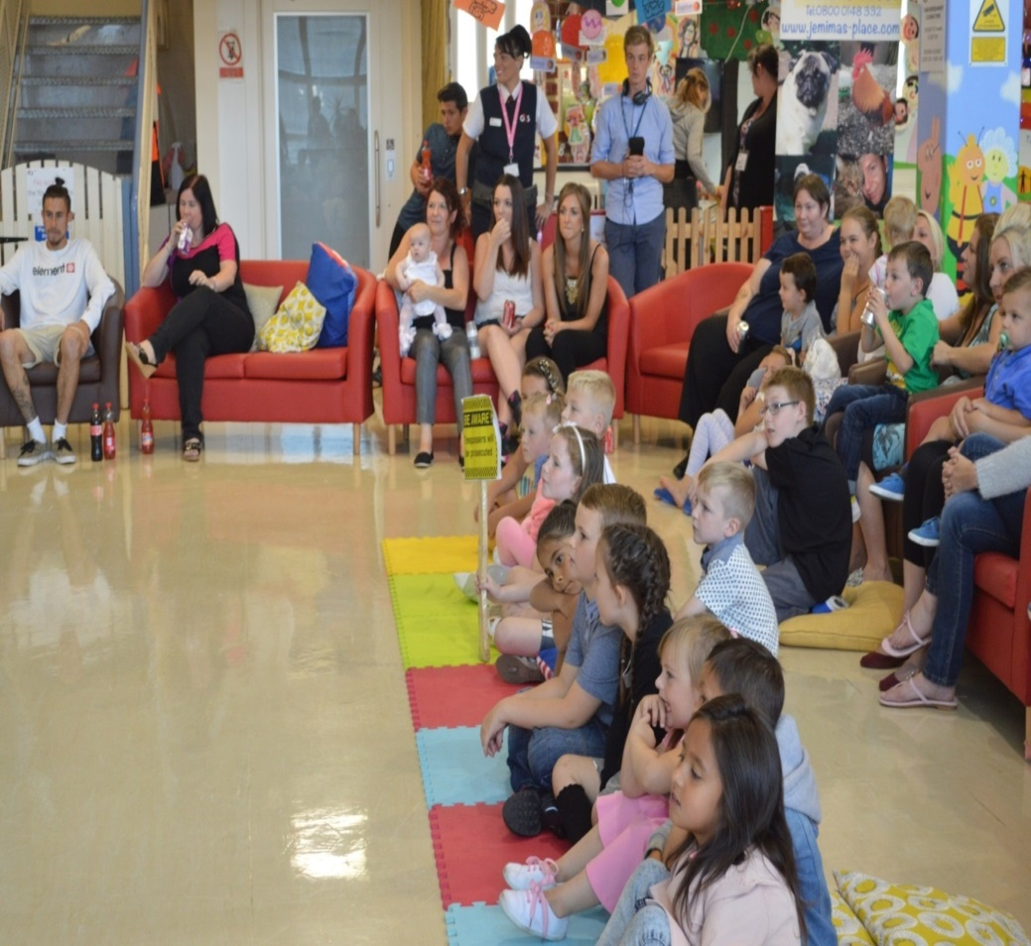
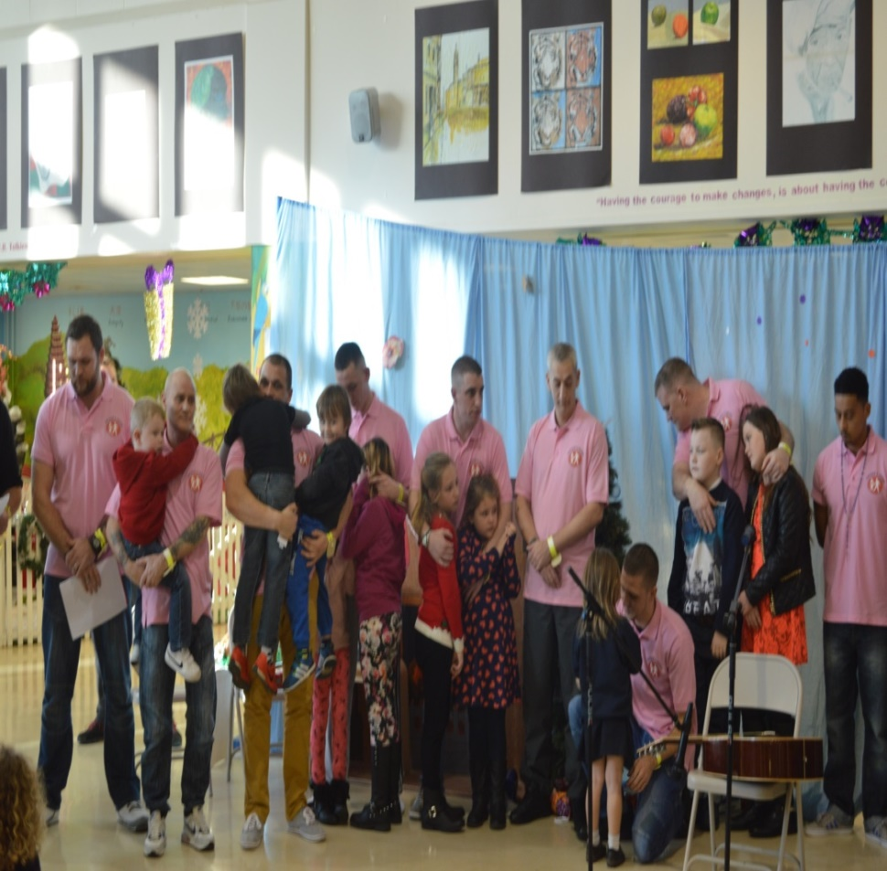
‘Family Man’ & ‘Fathers Inside’:
In partnership with Safe Ground UK since 2010

Slide 26
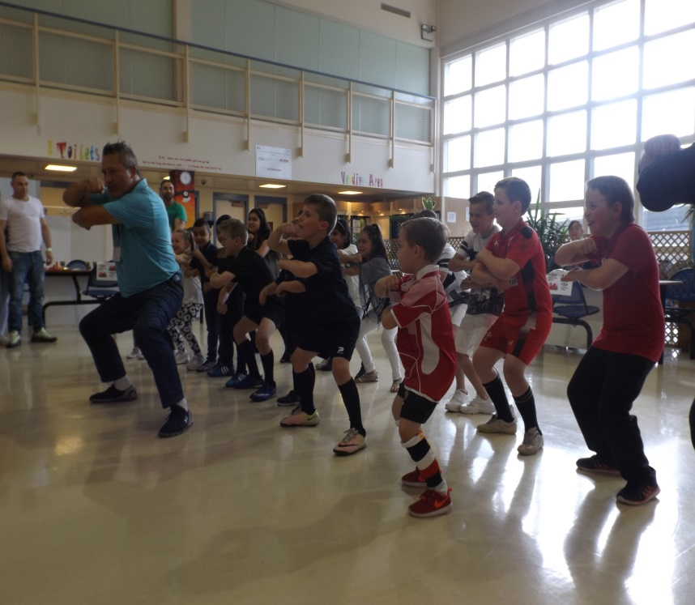
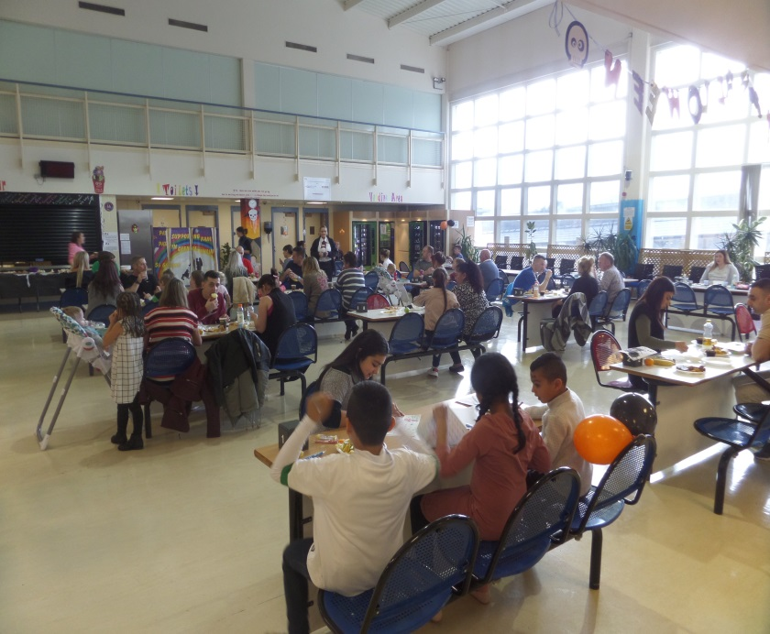
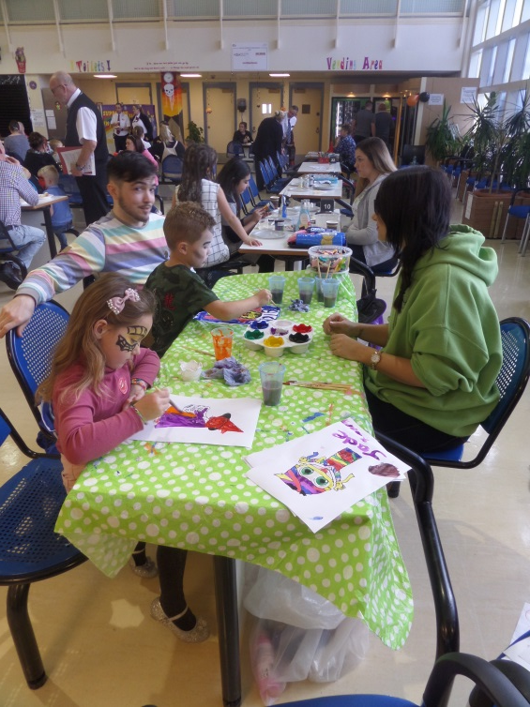
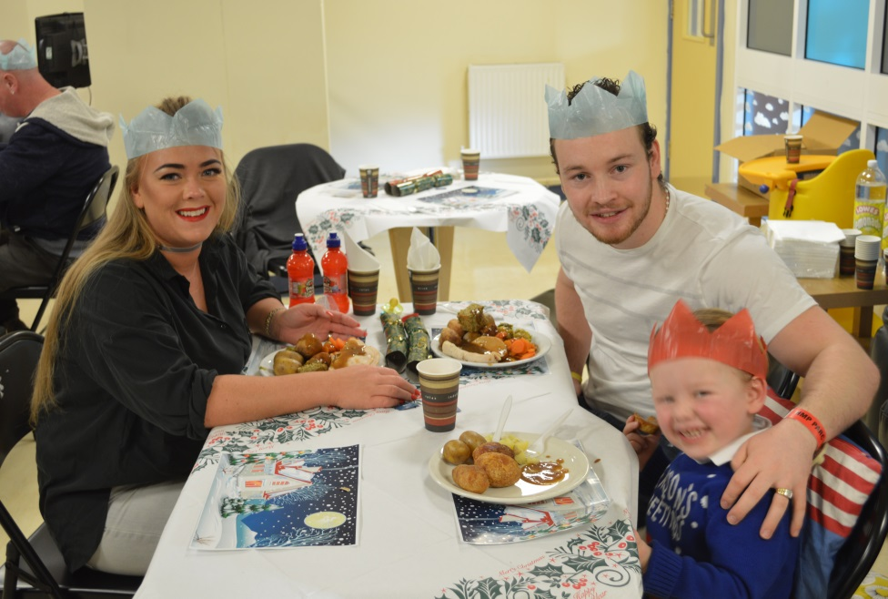
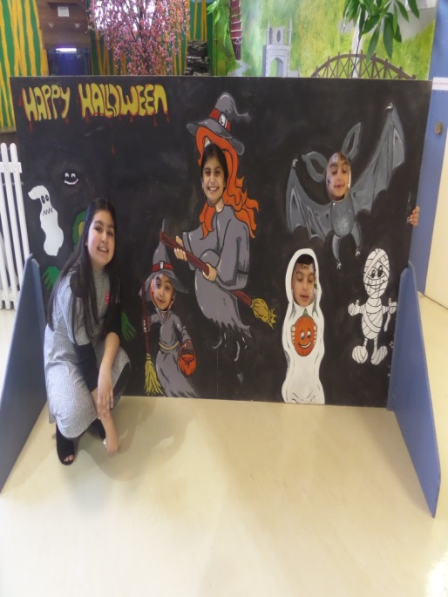
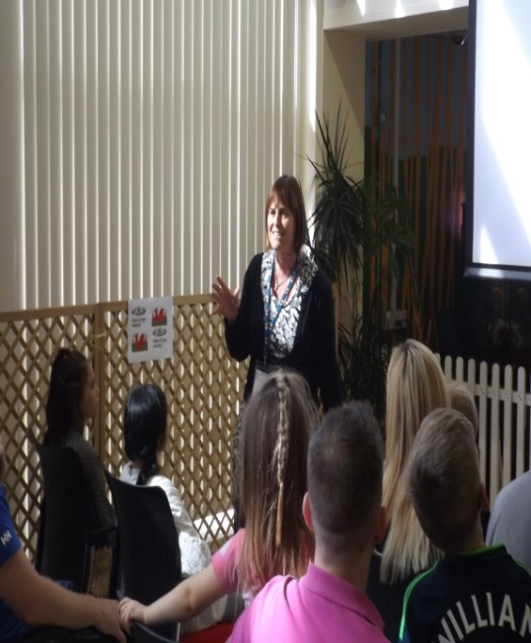
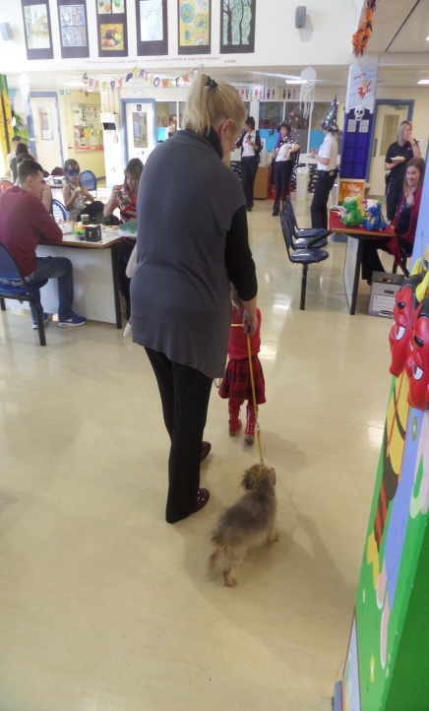
Family Day Events…Throughout the year

Slide 27
Positive family re-engagement:
Scouts Wales: At HMP Parc
Glyndwr Scouts Club
Founded 2014…
Still growing…

Slide 28
‘Knowing is not enough. We must apply. Willing is not enough. We must do.’
Bruce Lee

