Slide 1
Factors influencing why some people in prison do not receive social visits: an exploration to inform future policy and practice
Nabila Bhayat – Family Services

Slide 2
Samples
Quantitative Sample
Qualitative Sample

Slide 3
Alternative forms of contact maintained
Letters
Phone Calls
Email Services
Released on Day Release (RODR)

Slide 4
Factors affecting a lack of social visits resulting in alternative forms of contact to be used:

Slide 5
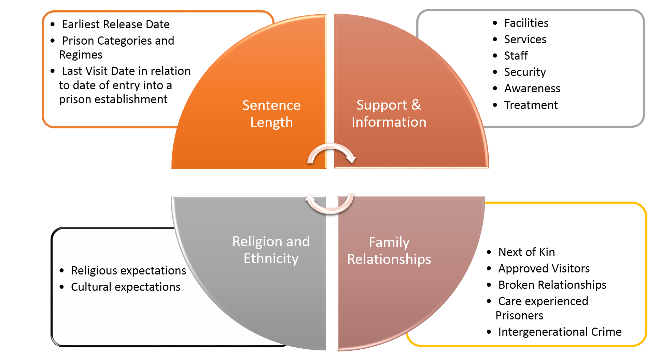
Additional factors influencing a lack of social visits:

Slide 6
Key Quotes
“Distance from home and public transport costs a lot more, so we opt for a car which means being reliant on others to drive you to the prison”
“Depending on how much money you have usually, dictates your level and frequency of social contact especially in regards to social visits.”
“There are no barriers to visiting but it can be difficult to book and depends on who is on the phone and the lines never open for 8:30am as advertised”.
“To go with more than one child is difficult because you can’t take a pram in and children so how many hands does one person physically have and children will eventually get fed up”.
“I am the root cause of why I am in this situation and the loneliness is a reality check”
“It’s a hard day emotionally – it’s a draining, upsetting and stressful not a fun day out”.
“I do my jail my way”

Slide 7
Thank you

