Slide 1
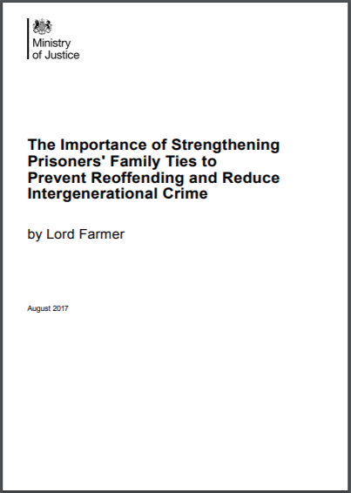
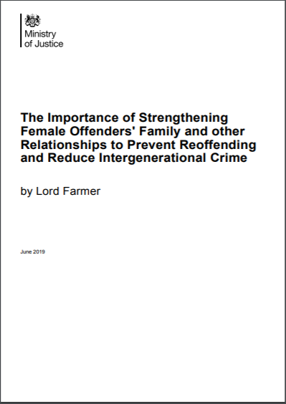
‘Farmer 2’: running the golden thread of relationships through all prison and CJS processes Dr Samantha Callan Lead Writer, Farmer Reviews 1 & 2 HMPPS National Family Conference October 17th 2019

Slide 6
Overview
Why Farmer 2 was commissioned
Family needs of women from different Black, Asian and Minority Ethnic (BAME) communities, and Foreign National Women (FNW)
Rationale behind key recommendations in F2

Slide 7
54 families in Cambridge University’s FAIR Study
19 had a member who identified themselves (or their children) as belonging to an ethnic minority
15 Black or Black British;
5 Gypsy or Traveller;
4 Mixed ethnicity;
2 Other;
1 Asian or Asian British.

Slide 8
Sophie Ellis, from the FAIR project team:
Categorisation disguises the rich complexities of ethnic and cultural heritage in the sample. There were families from many African and Caribbean countries, as well as Polish, English/Irish Travellers and Showmen and a variety of class backgrounds.
The ways in which families interact with services and prisons is not straightforward, and cultural factors can sometimes be poorly recognised/understood.

Slide 9
FN women’s relationships:
International phone calls expensive and hard to make to different time zones
Obstacles to obtaining ROTL and to family visiting the prison.
Language barriers make it harder to obtain jobs which help them pay for calls and support family
Fear of telling family members they are in prison due to stigma, possible abandonment or burdening them
Fear police will contact their family yet some have been trafficked and have lost all contact.

Slide 10
Muslim Women in Prison Project
Families do not visit prison to avoid further shame and dishonour
Community pressure and slurs to the izzat of her family makes it hard to accept women back
Families hide mothers’ criminality from children
Pakistani community saying: ‘prisons are for men’ men can go to prison, come out and then move on: it is a ‘manly’ thing to do.
Women would be greatly helped if there were an understanding of the concept of forgiveness in Islam.

Slide 11
Travellers’ relationships:
Ability to write letters home a major issue because many have not had a formal education
Difficulties booking whole family in for visits as they often do not have the correct documentation
Women less likely to access domestic violence services for fear of losing their children and wariness of police and local council
High numbers with complex needs and lack of family contact and relationships of trust can greatly exacerbate their anxiety.

Slide 12
Agenda/WiP research on BAME women in the CJS:
Black children experienced the highest number of ACEs of the cohort, followed by children of mixed heritage.
Many were single parents and had children living with extended family members and visiting was often very difficult.
More than half of black African and black Caribbean families in the UK are headed by a lone parent so issue disproportionately affects Black women and their families.

Slide 13
Early Intervention Recommendations:
Personal Circumstances File which belongs to her, not the state;
We need you and other stakeholders to help us get this right!
Police MG (Manual Guidance) forms to capture information about women’s dependants at the point of arrest.

Slide 14
Probation and Through- the-Gate Reforms:
Relationships at the heart of offender management before and after release:
Planning for accommodation post-release needs to start early enough to secure the best outcome.
Services to support family and other relational ties
Supervision arrangements should not ignore caring responsibilities, especially where recall is being considered
Local authority housing to take women’s prospective needs into account so she can be reunited with her children after leaving prison.

Slide 15
Better Custody
Virtual visits routinely available where no security or child welfare concerns
Prison-based social workers:
‘I need a wider range of professional specialists, especially ones who can make a difference by linking with community agencies. I need more family engagement workers and social workers on my team.’
Governor of HMP Low Newton

Slide 16
Thank You!

