Slide 1
Family and Significant Others Conference Holiday Inn Stevenage
17 October 2019

Slide 2
What we do
The Family Support Working Group (FSWG) was formed in 2016 with the purpose helping the estate to support familial relationships.
Our role was greatly expanded in 2017 with the launch of the Farmer Review when the Group took on the responsibility of facilitating prisons across England and Wales to implement the 19 recommendations that arose from the review.
We work with establishments, partners and colleagues across the MoJ to support the delivery of the Families and Significant Others agenda.

Slide 3
Our Strategic Objectives
The Families and Significant Others agenda supports HMPPS to:
Maintain the highest level of public protection
Keep prisons safe, secure and decent
Support offenders to reform
Reduce reoffending

Slide 4
Why it matters…
“Family and significant relationships are considered as a key means by which we can prevent reoffending and reduce the likelihood of intergenerational crime. Supporting a prisoner in a meaningful and constructive relationship with his or her family or significant others, should be a primary focus for anyone caring for those in custody who hope to achieve positive change and transform lives.”
*Quote from Delivering Effective Family Practice Operating Guidance issued December 2017

Slide 5
Why it matters…
“I've learned that people will forget what you said, people will forget what you did, but people will never forget how you made them feel..”
Maya Angelou
*

Slide 6
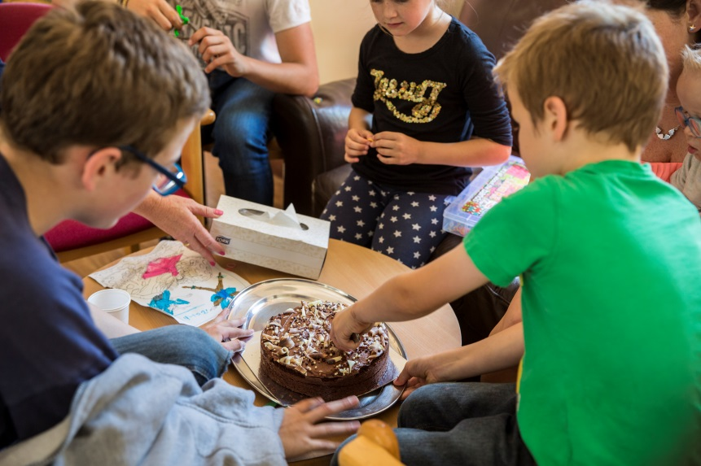
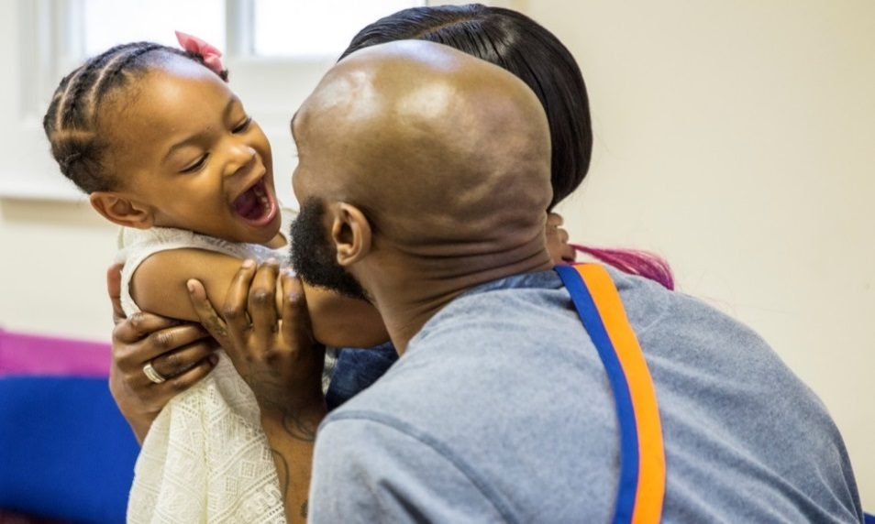
Why it matters…
“For a child I think it’s very intimidating
and scary to have to go through”
A parent referring to walking through a prison with their child on a visit
Each year, 310,000 children experience the imprisonment of a parent in England and Wales and half a million visits are made by children to public prisons

Slide 7
Why it matters…
Prisoners who receive visits from family members are 39% less likely to reoffend
Reoffending rates are 21 percentage points higher for people who said they had not received family visits whilst in prison compared to those who had*
Around 43% of prisoners lose contact with their families
Only three in ten prisoners reported that it was easy or very easy for family to visit them at their current prison – 16% said they did not receive visits*
*Statistics taken from Bromley Briefings Prison Factfile Autumn 2017

Slide 8
Assisted Prison Visits Unit rebranding On 1st August 2019 the Unit was renamed The core services are now known as:
Help With Prison Visits
PO Box 17594 Birmingham B2 2QP
0300 063 2100
helpwithprisonvisits@justice.gov.uk
Find A Prisoner
PO Box 17594 Birmingham B2 2QP
findaprisoner@justice.gov.uk
Victim Helpline
PO Box 17594 Birmingham B2 2QP
0300 060 6699
victim.helpline@justice.gov.uk
Visits Booking Service
PO Box 17594 Birmingham B2 2QP
visits.booking@justice.gov.uk

Slide 9
Did you know?
The Family Services Contact Centre has provided an ‘in house’ bespoke visits booking service since 2011 and recently expanded to 22 public sector prisons.
A contact centre approach was developed to allow legal/official visitors to use both email and phone service and social visitors both online bookings (24/7 availability) and phone calls – not losing that personal interaction.
In 2018 we made over 200,000 bookings on behalf of prisons
Handled around 215,000 calls relating to prison visits
Our USP:
Opening hours from 9am – 6pm Monday to Friday
Front and Back office approach to ensure all business areas - legal and social visits requests are met
Birmingham based location and economies of scale will reduce staffing costs which could be reinvested into family work.
If you would like to know more…
Please speak to us here today or contact Family Services at Family Services Management in the GAL

Slide 10
Did you know?
Family Services contributes towards the cost of travel to prison visits. It is open to close family members and significant others who are on a low income and allows for one visit every two weeks.
During January 2019 Family Services contributed to the cost of 2983 unique visits.
The average cost per visit was £33.11
Customers can claim directly online at gov.uk/helpwithprisonvisits.

Slide 11
Lord Michael Farmer
Lord Michael Farmer is a Conservative Peer who advocates government policy and services which strengthen family ties as a way to help people to realise their potential.
Chair of Farmer Review (August 2017) on Importance of Strengthening Prisoners' Family Ties to Prevent Reoffending and Intergenerational Crime Partner and contributor to the Strengthening Families Manifesto to integrate the importance of family across all government departments
Lord Farmer’s second review (June 2019) looks at strengthening family and other relational ties across both custody and the community through the lens of female offenders. It finds that supporting women to build and maintain healthy relationships is key to rehabilitation and reducing intergenerational crime.

Slide 12
Family Strategies Working Group
The success of the family agenda is supported by a small team which include the following colleagues:
Simon Marshall: Deputy Director – Rehabilitation and Support Services Group HMPPS
Tim Lloyd: Head of Family Services
Dr Angela Herbert MBE: Family Advisor - MoJ
Stuart Harrington: HMPPS Family Communications Lead
FSWG associate:
Richard Nicholls: Head of Operations CLINKS
Policy leads and colleagues with specialist knowledge also contribute to the families agenda to enable positive engagement and relationships between prisoners’ their family and significant others.

Slide 13
Our partner organisations
Barnardo’s Sodexo Justice Services
Choices Consultancy Services Spurgeons
FAST VCSG
FoPP (Sodexo) YJB
G4S
HALOW
JIGSAW
LAT
NEPACS
Ormiston
Pact
POPs
PSS
SERCO

Slide 14
Today’s Speakers
Mariam
Entrepreneur, author & founder of the UK's leading female mentoring initiative.
Mariam is passionate about transforming the lives of women within her community. After giving birth to her daughter whilst in prison, Mariam witnessed first-hand the lack of support available to women not only in her situation, but those in the corporate and business space. From here she founded Europe’s leading female mentoring initiative, Mentor MatcHER. Mentor MatcHER aims to change the lives of women through mentorship and has worked with some of the country’s most inspirational women across various sectors including Amanda Wakeley OBE, Victoria Beckham, Melissa Odabash to name a few. Mariam has since launched another leading female platform Women of the City (WOTC) and has already collaborated with several of the city’s magical circle legal firms, HSBC, EY, Deutsche Bank, American Express and AON. WOTC is determined to challenge the traditional view of corporate social responsibility by making it more human. Alongside this Mariam is a Pastor at SPAC Nation Church and has been able to support over 3,500 women in business and her local community.

Slide 15
Today’s Speakers
Andy Keen-Downs
Chief Executive of Pact (the Prison Advice & Care Trust)
Andy Keen-Downs has been Chief Executive of Pact since 2005, steering the charity through a period of great change and growth. Since 2015 he has been Group CEO, following the establishment of Pact Futures CIC as a wholly owned, independent subsidiary. Andy has worked in the voluntary sector for much of his working life, and was previously Deputy Director at Gingerbread (One Parent Families). Previously, Andy held senior posts with the National Childbirth Trust and with Centrepoint. Andy acts as a pro-bono advisor to Lord Michael Farmer and to Bishop Richard Moth, and is regularly sought for his expertise on how to reduce re-offending and the risk of inter-generational offending.

Slide 16
Today’s Speakers
Dr Samantha Callan
Parliamentary Adviser to Lord Farmer
Dr Samantha Callan is a published academic and policy expert in the fields of family relationships, family law, early years, mental health and domestic abuse. As Parliamentary Adviser to Lord Farmer she was lead writer of both Farmer Reviews commissioned and published by the Ministry of Justice: The Importance of Strengthening Prisoners' Family Ties to Prevent Reoffending and Reduce Intergenerational Crime, which focused on men in prison and The Importance of Strengthening Female Offenders' Family and other Relationships to Prevent Reoffending and Reduce Intergenerational Crime which looked across women’s experiences in the criminal justice system.
Previously she was Special Adviser for Family and Society in the Conservative Policy Unit and Associate Director at the Centre for Social Justice.

Slide 17
Today’s Speakers
Nabila Bhayat
Researcher for Family Services HMPPS

Slide 18
Today’s Speakers
Sara Rattenbury
Engagement Manager at Barnardo’s
Sara Rattenbury works as an Engagement Manager for Barnardo’s, developing strategies for working with those who have a parent or close relative in prison. She previously worked within Children’s Centres and Family Support services ultimately becoming an operational manager. While doing this she studied for a research MA in Education completing her dissertation on the ‘Impact of Paternal Imprisonment on Father/Child relationships and a child’s outcomes’. She is currently part of a research team undertaking a needs assessment of British Armed Forces veterans in custody and their families. Her interest in families impacted by imprisonment stems from her days of volunteering within prison visits at a prison local to her.

Slide 19
Today’s Speakers
Zoe Cook
Administrator for the CAPO, CLES & NICCO Services at Barnardo’s

Slide 20
Today’s Speakers
Polly Wright
Freelance consultant delivering research, training and development across children’s services and the criminal justice system.
Polly is a freelance consultant delivering research, training and development across children’s services and the criminal justice system. She is currently the Chair of the Bristol and South Gloucestershire Steering group on Children Affected by Parental Offending. Previously a Children’s Services Manager for Barnardo’s, Polly managed the National Information Centre on Children of Offenders (NICCO) and the Children Affected by Parental Offending Engagement Service, working with both prisons and local authorities to develop practice to meet the needs of prisoners and their families. Polly has co-authored the ‘Practice Guide on Supporting Children and Families affected by a family member’s offending’ (Barnardo’s, 2017).
Commissioned by Clinks, Polly has recently completed work on the 10 Prison Project Think Family programme, working with 4 establishments to review and develop their practice around family engagement.

Slide 21
Today’s Speakers
Deborah Searson-Smith
Head of Reducing Reoffending at HMP Nottingham.
Deborah is currently Head of Reducing Reoffending at HMP Nottingham. She has over 20 years of experience working in HMPPS including time at Glen Parva, Whatton and Wellingborough.

Slide 22
Today’s Speakers
Esther Dainton
HMP Ford
.

Slide 23
Today’s Speakers
Diane Caddle
Executive Director - Prison Safety and Rehabilitation.
Executive Director - Prison Safety and Rehabilitation. Responsible for major programmes covering prison safety, addressing offender behaviour, the provision of education, work and training and preparation for release. Diane is also Lead for diversity and inclusion with a particular focus on implementing recommendations from David Lammy MP's Review with respect to increased recruitment and progression of BAME staff and better a treatment of staff and prisoners with disabilities, who are LGBT+ and the provision of a prison chaplaincy which reflects different faiths.

Slide 24
Today’s Speakers
Simon Marshall
Head of Rehabilitation Services Group HMPPS
Simon is Head of Rehabilitation Services Group, Her Majesties Prison and Probation Service. He is also responsible for overseeing both current delivery and reform of adult rehabilitation services in custody, the community and through the prison gate. This includes providing services and support to front-line prison and probation leaders around areas such as health, social care, education employment and supporting relationships with families and significant others.

Slide 25
Today’s Speakers
Mohammad Hanif
Chief Operating Officer at Arooj
Hanif has over 30 years’ experience working in a variety of senior management positions in the public, private and voluntary sectors. Having worked in, and with, local and national government, he also serves on a number of boards and committees, including Prisons Equality Action Boards and the Reducing Reoffending Third Sector Advisory Board. More generally, his interests are in the effects of the racialisation of Islam and how that impacts on Muslims in the community and in all aspects of the CJS. He is also interested in the practice of Islam and has written a book titled ‘Islam - An Introduction’. Hanif has been involved in several research projects as a co-researcher including the 'Faith, Families and Crime' project funded by the Barrow Cadbury Trust. He is the Chief Operating Officer in Arooj, an initiative that focuses on working with Muslim and Black, Asian and minority ethnic families and offenders; providing support for them to realise their goals through rehabilitation and social reintegration support, whilst in custody and through the gate.

Slide 26
Today’s Speakers
Dr Christine Hough
Senior Lecturer at the University of Central Lancashire
Christine was a Senior Lecturer at the University of Central Lancashire for eight years. She was co-researcher for a research project funded by the Barrow Cadbury Trust - Faith, Families and Crime – which explores the impact of the criminal justice system on Muslim families, due to a family member’s involvement with the Criminal Justice System (CJS). Her most recent paper on these findings has been submitted for peer review to the British Journal of Community Justice, for the upcoming special issue. Christine was also the Project Investigator for the primary research project, ReachingOut, which provided a critical evaluation of a rehabilitation mentoring model for BAME Muslim ex-offenders, located in North West England. The findings from this were published in the European Journal of Probation an August 2016

Slide 27
Please feel free to Tweet about:
#hmppsfamiliesconference

